Slide 1
Meeting on May 28
Takumi Shiota
May 28, 2025
@Maastricht univ.

Slide 2

Progress report
Program flow
Enumerate non-isomorphic, connected graphs with minimum degree at least 3 using Nauty
Remove non-planar graphs (Boost (c++))
Remove graphs that are not 3-connected (NetworkX)
Apply degree constraints (NetworkX) ← Newly implemented
Draw and save the graphs (NetworkX)
Today’s report
I present five families of polyhedral graphs with consecutively increasing numbers of vertices $n$.

Slide 3
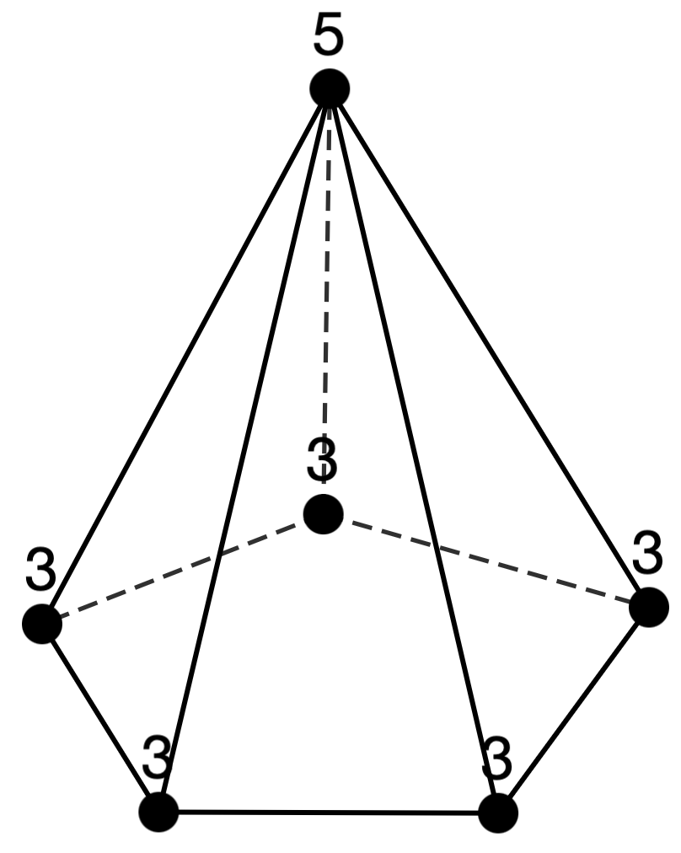
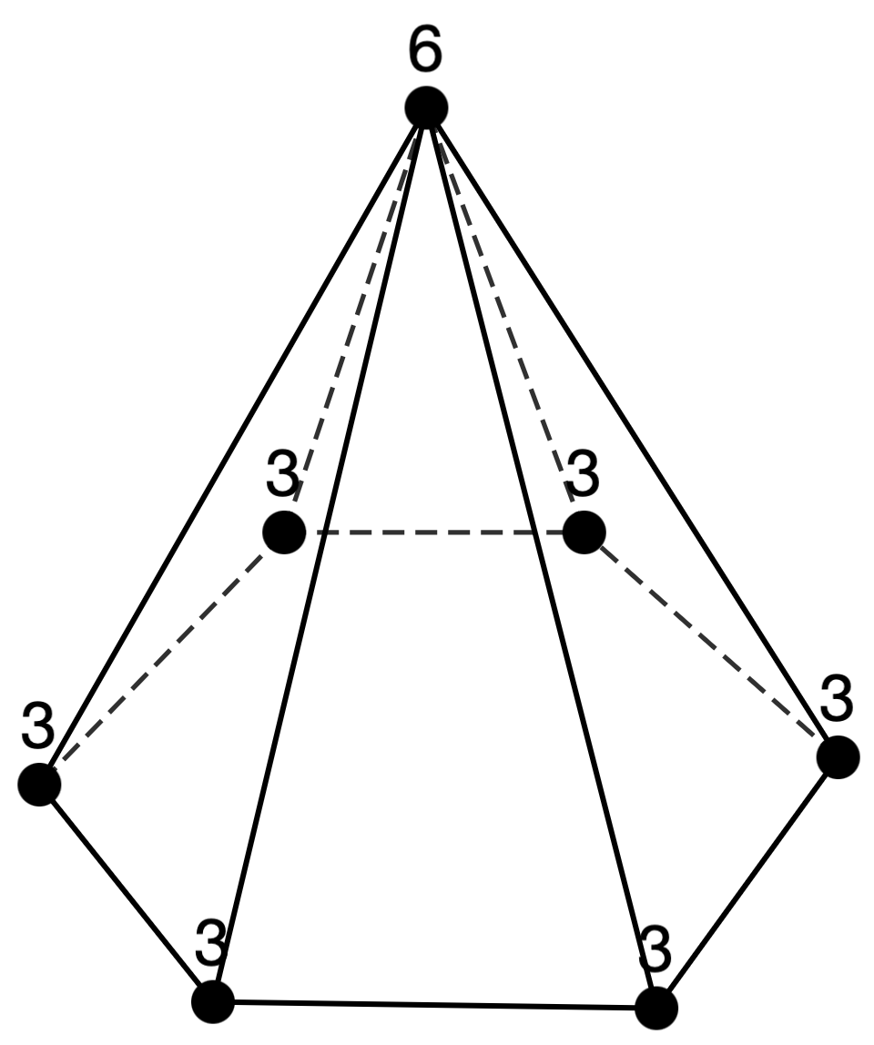
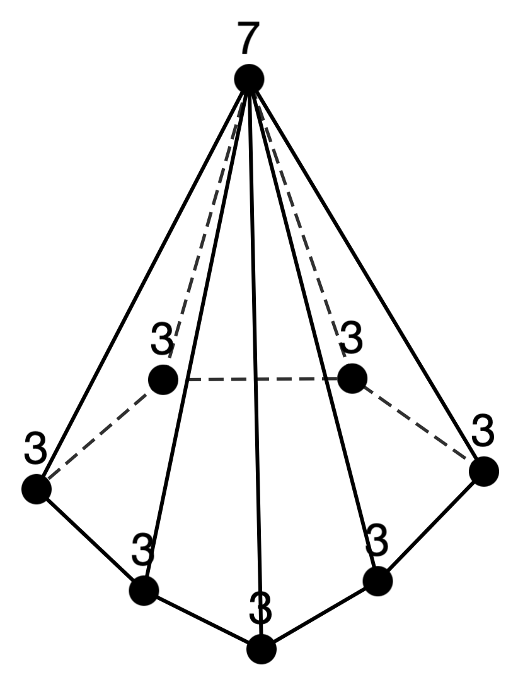
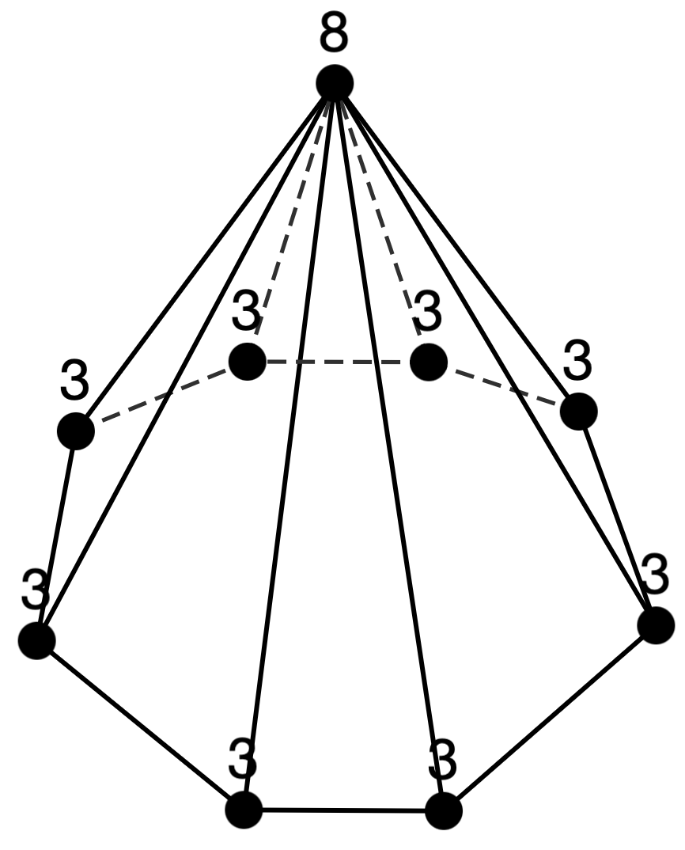
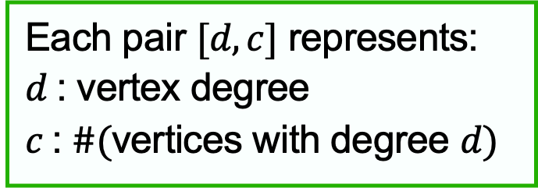
Classical named polyhedral families
Pyramid
Notation
Each pair $[d,c]$ represents:
$d$: vertex degree
$c$: $\#($vertices with degree $d)$
n=4: [3,3][3,1] (=[3,4])
n=5: [3,4][4,1]
n=6: [3,5][5,1]
n=7: [3,6][6,1]
n=8: [3,7][7,1]
n=9: [3,8][8,1]
n=10: [3,9][9,1]
n=11: [3,10][10,1]

Slide 4
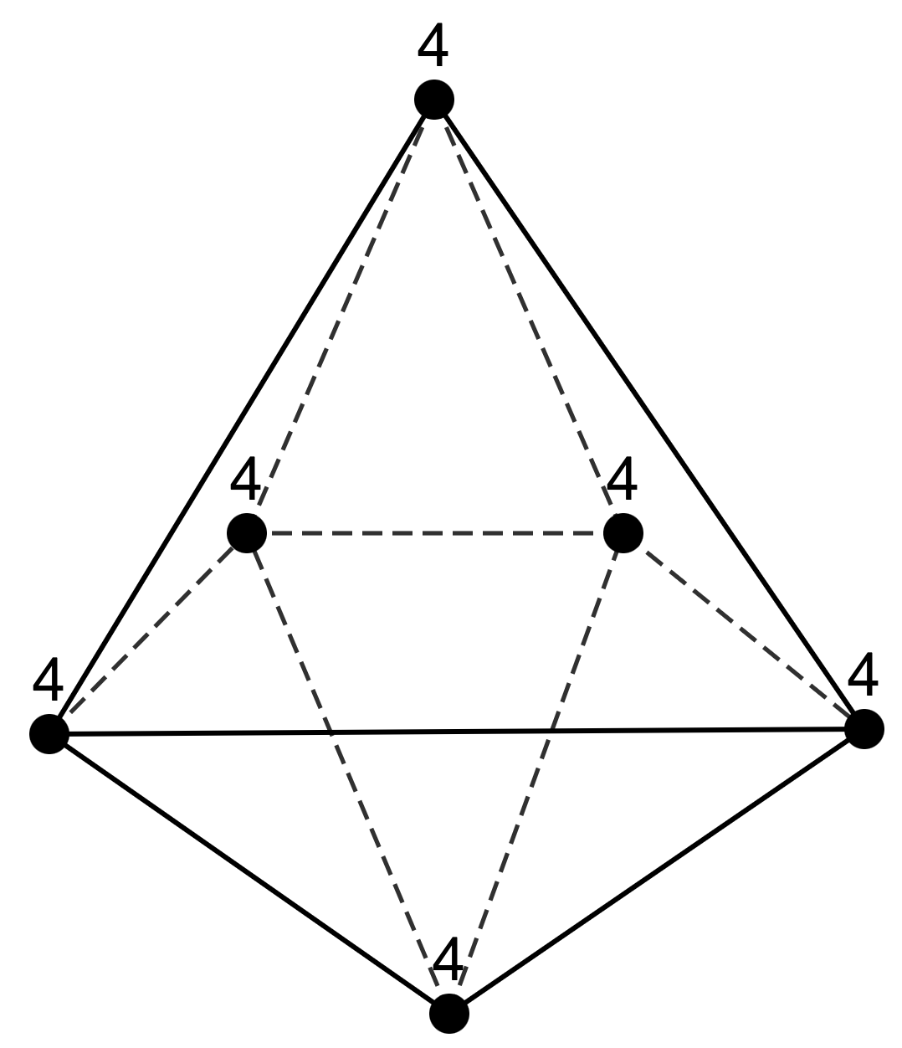
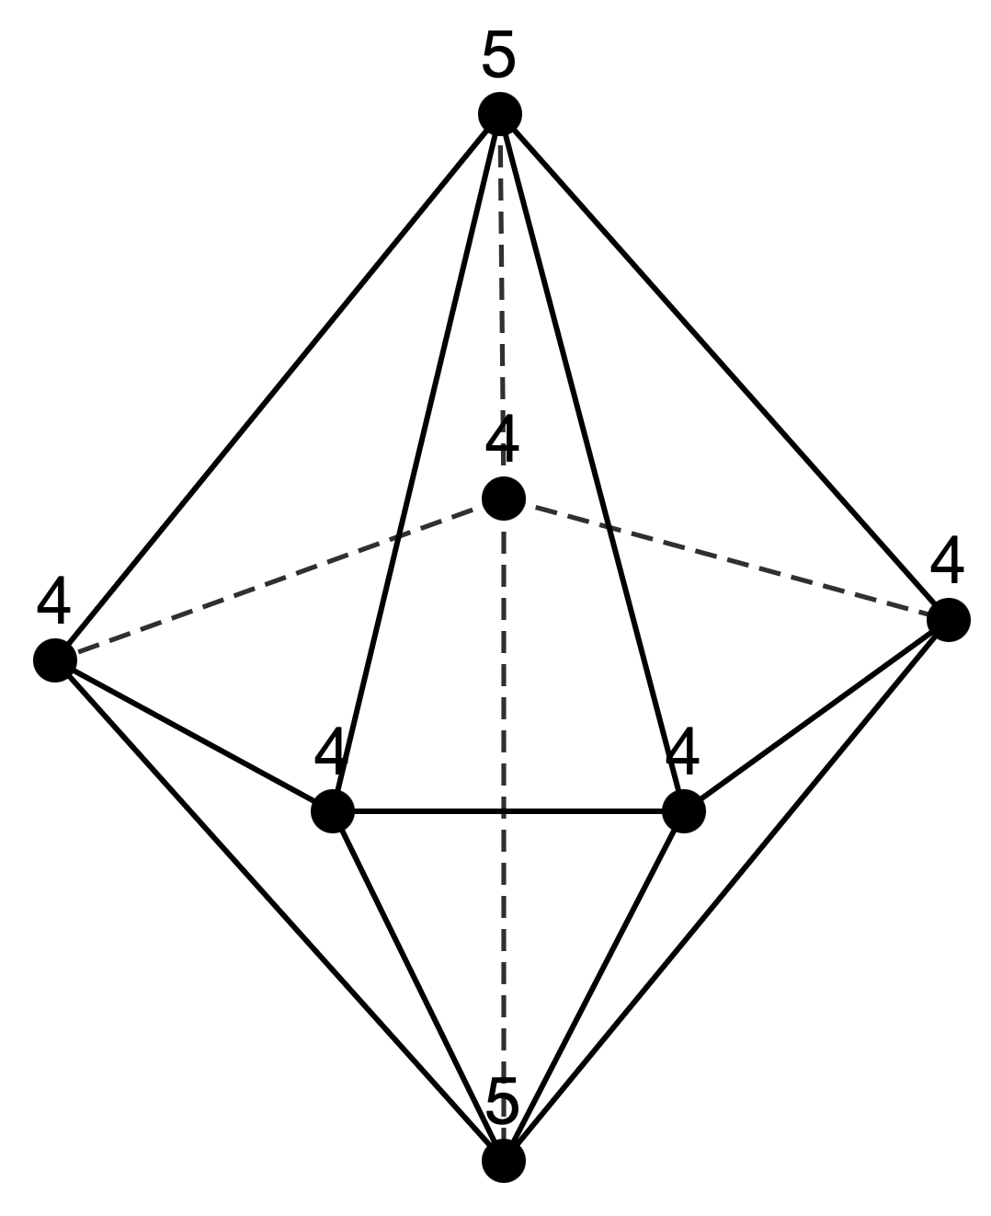
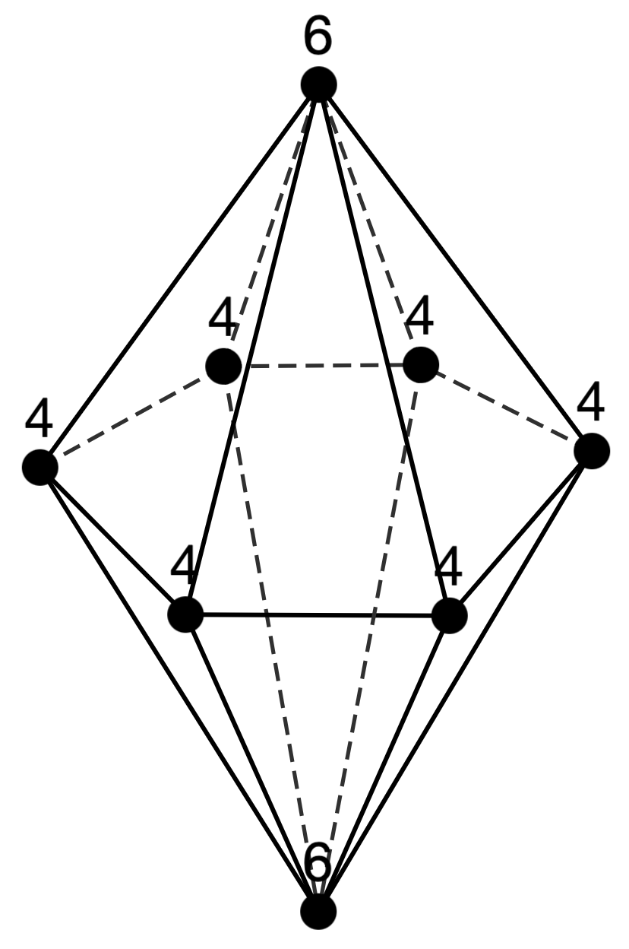
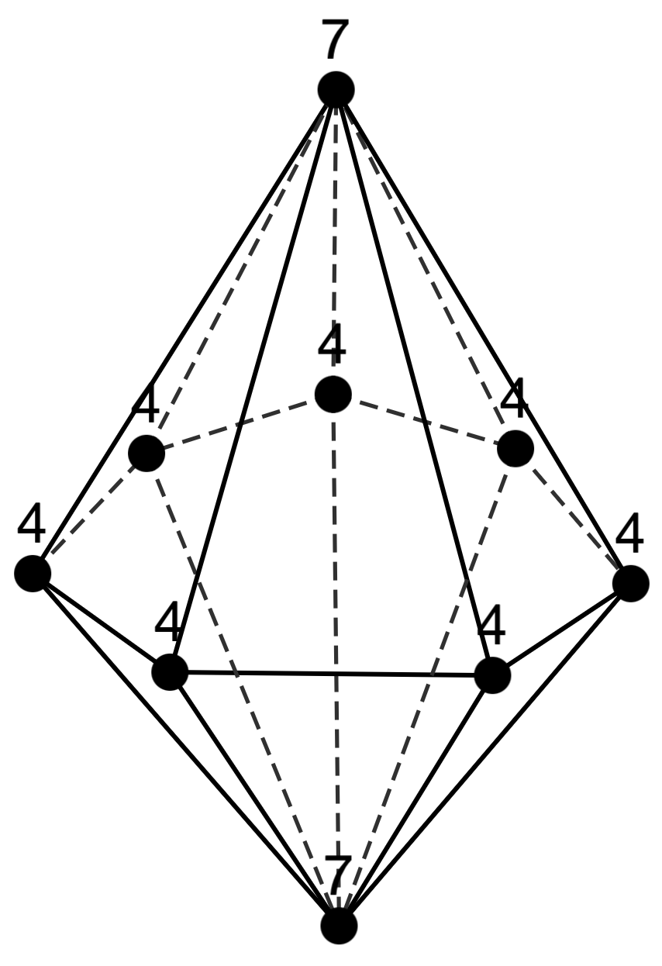
Classical named polyhedral families
Notation
Bipyramid
Each pair $[d,c]$ represents:
$d$: vertex degree
$c$: $\#($vertices with degree $d)$
n=5: [4,3][3,2](=[3,2][4,3])
n=6: [4,4][4,2](=[4,6])
n=7: [4,5][5,2]
n=8: [4,6][6,2]
n=9: [4,7][7,2]
n=10: [4,8][8,2]
n=11: [4,9][9,2]

Slide 5
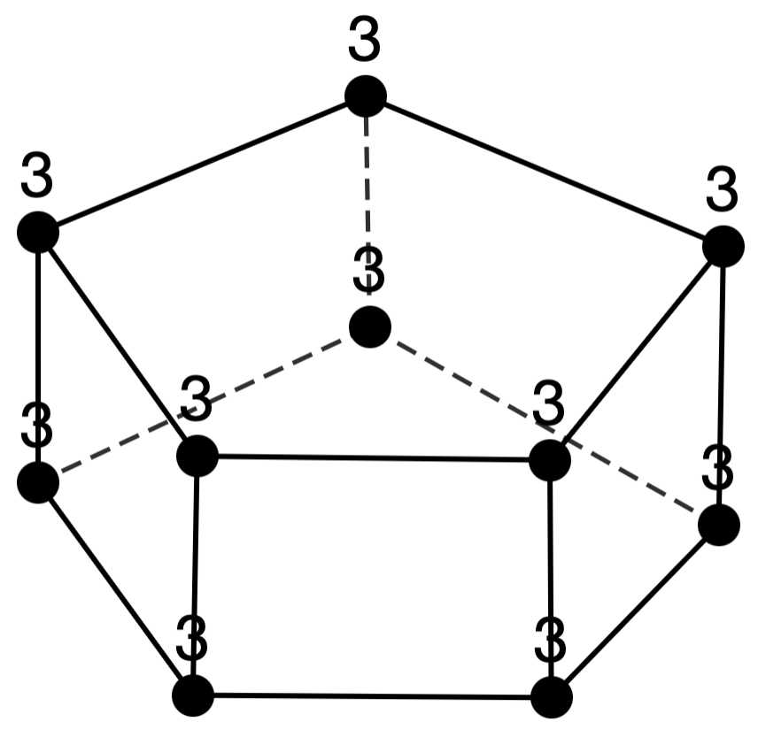
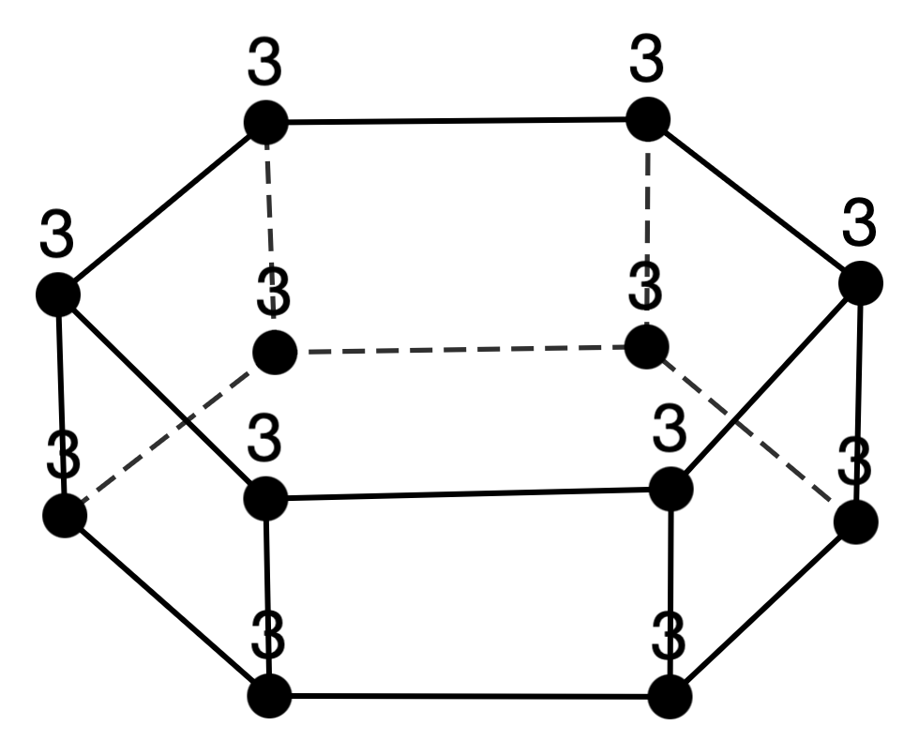
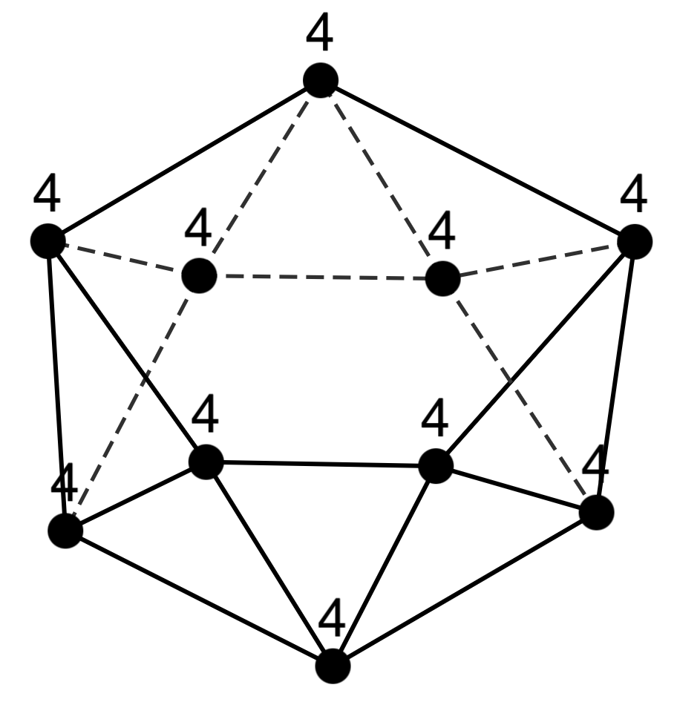
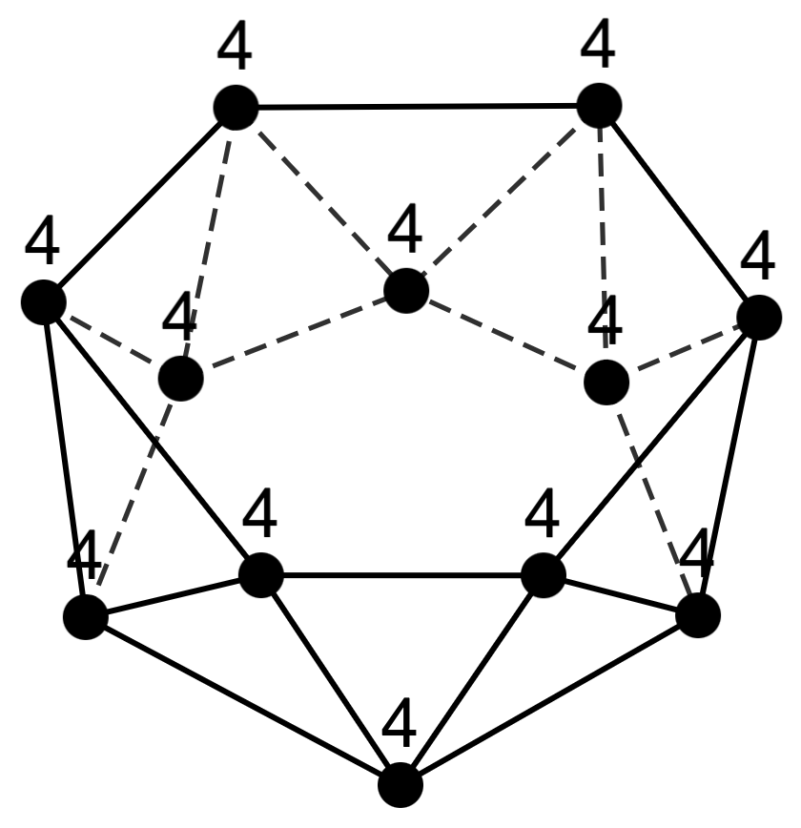
Classical named polyhedral families
Prism
n=6: [3,6]
n=8: [3,8]
n=10: [3,10]
n=12: [3,12]
Antiprism
n=6: [4,6]
n=8: [4,8]
n=10: [4,10]
n=12: [4,12]

Slide 6
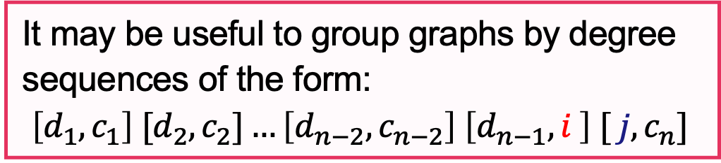
Insights from [deg., cnt.] observations
Prism
Pyramid
Bipyramid
n=6: [3,6]
n=8: [3,8]
n=10: [3,10]
n=12: [3,12]
n=5: [3,4][4,1]
n=6: [3,5][5,1]
n=7: [3,6][6,1]
n=8: [3,7][7,1]
n=9: [3,8][8,1]
n=10: [3,9][9,1]
n=11: [3,10][10,1]
n=5: [4,3][3,2]
n=6: [4,4][4,2]
n=7: [4,5][5,2]
n=8: [4,6][6,2]
n=9: [4,7][7,2]
n=10: [4,8][8,2]
n=11: [4,9][9,2]
Antiprism
n=6: [4,6]
n=8: [4,8]
n=10: [4,10]
n=12: [4,12]
Based on these observations…
It may be useful to group graphs by degree sequences of the form:
$$\left[d_{1}, c_{1}\right] [d_{2},c_{2}]…\left[d_{n−2}, c_{n−2}\right] \left[d_{n−1}, i \right] [ j, c_{n}]$$

Slide 7
List of obtained [deg., cnt.] sequences
Sequence 1
Sequence 2
n=6: [3,3][4,2][5,1]
n=7: [3,4][4,2][6,1]
n=8: [3,5][4,2][7,1]
n=9: [3,6][4,2][8,1]
n=10: [3,7][4,2][9,1]
n=11: [3,8][4,2][10,1]
n=7: [3,3][4,3][5,1]
n=8: [3,4][4,3][6,1]
n=9: [3,5][4,3][7,1]
n=10: [3,6][4,3][8,1]
n=11: [3,7][4,3][9,1]
Sequence 3
Sequence 4
n=7: [3,6][4,1]
n=8: [3,7][5,1]
n=9: [3,8][6,1]
n=10: [3,9][7,1]
n=11: [3,10][8,1]
n=7: [3,1][4,5][5,1]
n=8: [3,2][4,5][6,1]
n=9: [3,3][4,5][7,1]
n=10: [3,4][4,5][8,1]
n=11: [3,5][4,5][9,1]

Slide 8
List of obtained [deg., cnt.] sequences
Sequence 5
Sequence 6
n=7: [3,2][4,2][5,2][6,1]
n=8: [3,3][4,2][5,2][7,1] n=9: [3,4][4,2][5,2][8,1] n=10: [3,5][4,2][5,2][9,1]
n=11: [3,6][4,2][5,2][10,1]
n=7: [3,2][4,4][6,1]
n=8: [3,3][4,4][7,1]
n=9: [3,4][4,4][8,1]
n=10: [3,5][4,4][9,1]
n=11: [3,6][4,4][10,1]
Sequence 7
Sequence 8
n=7: [3,3][5,3][6,1]
n=8: [3,4][5,3][7,1]
n=9: [3,5][5,3][8,1]
n=10: [3,6][5,3][9,1]
n=11: [3,7][5,3][10,1]
n=7: [3,2][4,2][5,2][6,1]
n=8: [3,2][4,2][5,3][7,1]
n=9: [3,2][4,2][5,4][8,1]
n=10: [3,2][4,2][5,5][9,1]
n=11: [3,2][4,2][5,6][10,1]

Slide 9
List of obtained [deg., cnt.] sequences
Sequence 9
Sequence 10
n=8: [3,4][4,2][5,2]
n=9: [3,4][4,3][6,2]
n=10: [3,4][4,4][7,2]
n=11: [3,4][4,5][8,2]
n=8: [3,3][4,4][5,1]
n=9: [3,4][4,4][6,1]
n=10: [3,5][4,4][7,1]
n=11: [3,6][4,4][8,1]
Sequence 11
Sequence 12
n=8: [3,5][4,2][5,1]
n=9: [3,6][4,2][6,1]
n=10: [3,7][4,2][7,1]
n=11: [3,8][4,2][8,1]
n=8: [3,3][4,3][5,1][6,1]
n=9: [3,3][4,3][5,2][7,1]
n=10: [3,3][4,3][5,3][8,1]
n=11: [3,3][4,3][5,4][9,1]

Slide 10
List of obtained [deg., cnt.] sequences
Sequence 13
Sequence 14
n=8: [3,2][4,3][5,2][6,1]
n=9: [3,3][4,3][5,2][7,1]
n=10: [3,4][4,3][5,2][8,1]
n=11: [3,5][4,3][5,2][9,1]
n=8: [3,2][4,3][5,2][6,1]
n=9: [3,2][4,3][5,3][7,1]
n=10: [3,2][4,3][5,4][8,1]
n=11: [3,2][4,3][5,5][9,1]
Sequence 15
Sequence 16
n=8: [3,3][4,2][5,1][6,2]
n=9: [3,3][4,3][5,1][7,2]
n=10: [3,3][4,4][5,1][8,2]
n=11: [3,3][4,5][5,1][9,2]
n=8: [3,4][4,2][5,1][7,1]
n=9: [3,4][4,2][5,2][8,1]
n=10: [3,4][4,2][5,3][9,1]
n=11: [3,4][4,2][5,4][10,1]

Slide 11
List of obtained [deg., cnt.] sequences
Sequence 17
Sequence 18
n=8: [3,4][4,2][6,2]
n=9: [3,4][4,3][7,2]
n=10: [3,4][4,4][8,2]
n=11: [3,4][4,5][9,2]
n=8: [3,3][4,2][5,2][7,1]
n=9: [3,3][4,2][5,3][8,1]
n=10: [3,3][4,2][5,4][9,1]
n=11: [3,3][4,2][5,5][10,1]
Sequence 19
Sequence 20
n=8: [3,1][4,6][5,1]
n=9: [3,2][4,6][6,1]
n=10: [3,3][4,6][7,1]
n=11: [3,4][4,6][8,1]
n=8: [3,2][4,4][5,1][7,1]
n=9: [3,2][4,4][5,2][8,1]
n=10: [3,2][4,4][5,3][9,1]
n=11: [3,2][4,4][5,4][10,1]

Slide 12
List of obtained [deg., cnt.] sequences
Sequence 21
Sequence 22
n=8: [3,1][4,3][5,3][6,1]
n=9: [3,2][4,3][5,3][7,1]
n=10: [3,3][4,3][5,3][8,1]
n=11: [3,4][4,3][5,3][9,1]
n=8: [3,1][4,4][5,1][6,2]
n=9: [3,1][4,5][5,1][7,2]
n=10: [3,1][4,6][5,1][8,2]
n=11: [3,1][4,7][5,1][9,2]
Sequence 23
n=8: [3,2][4,2][5,3][7,1]
n=9: [3,3][4,2][5,3][8,1]
n=10: [3,4][4,2][5,3][9,1]
n=11: [3,5][4,2][5,3][10,1]

Slide 13
List of obtained [deg., cnt.] sequences
Sequence 24
Sequence 25
n=6: [3,3][4,2][5,1]
n=8: [3,3][4,4][7,1]
n=10: [3,3][4,6][9,1]
n=6: [3,4][4,2]
n=8: [3,6][5,2]
n=10: [3,8][6,2]
Sequence 26
Sequence 27
n=7: [3,3][4,3][5,1]
n=9: [3,3][4,5][7,1]
n=11: [3,3][4,7][9,1]
n=7: [3,2][4,3][5,2]
n=9: [3,4][4,3][6,2]
n=11: [3,6][4,3][7,2]
Sequence 28
Sequence 29
n=7: [3,4][4,1][5,2]
n=9: [3,4][4,3][6,2]
n=11: [3,4][4,5][7,2]
n=7: [3,4][4,1][5,2]
n=9: [3,6][4,1][6,2]
n=11: [3,8][4,1][7,2]

Slide 14
List of obtained [deg., cnt.] sequences
Sequence 30
Sequence 31
n=7: [3,4][4,2][6,1]
n=9: [3,4][4,4][8,1]
n=11: [3,4][4,6][10,1]
n=7: [3,5][4,1][5,1]
n=9: [3,5][4,3][7,1]
n=11: [3,5][4,5][9,1]
Sequence 32
Sequence 33
n=7: [3,2][4,2][5,2][6,1]
n=9: [3,2][4,4][5,2][8,1]
n=11: [3,2][4,6][5,2][10,1]
n=7: [3,2][4,3][6,2]
n=9: [3,4][4,3][7,2]
n=11: [3,6][4,3][8,2]
Sequence 34
n=7: [3,2][4,4][6,1]
n=9: [3,2][4,6][8,1]
n=11: [3,2][4,8][10,1]

Slide 15
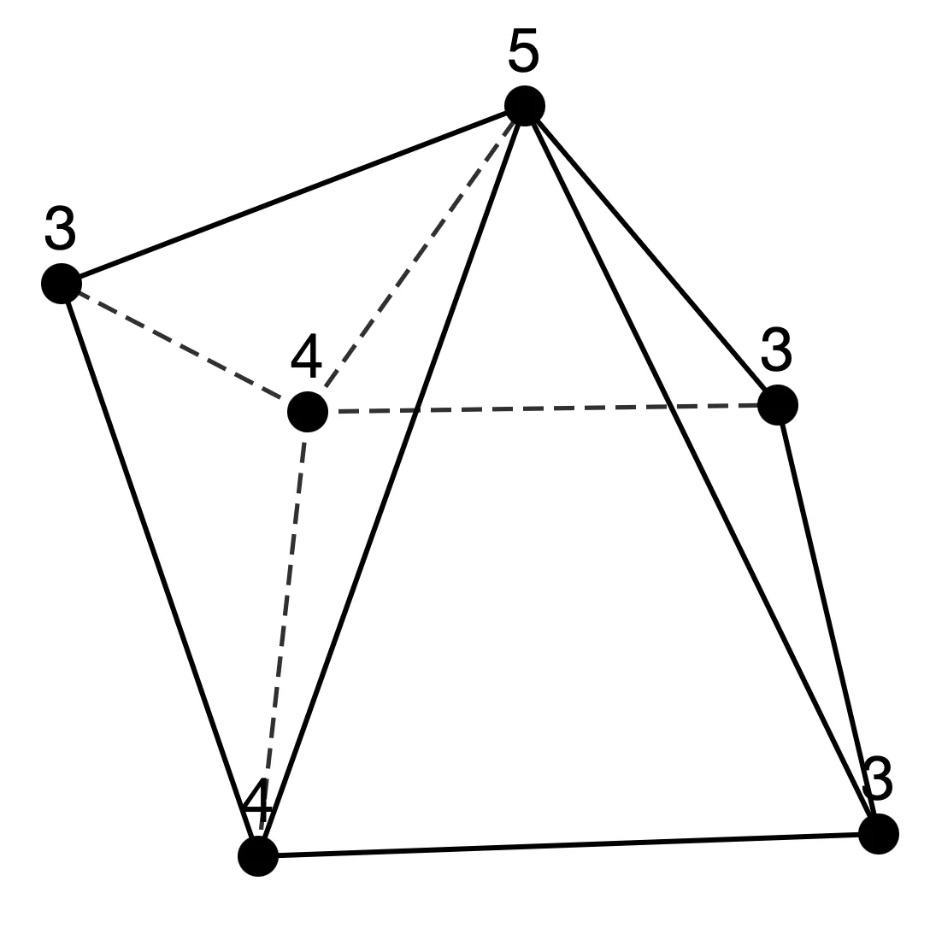
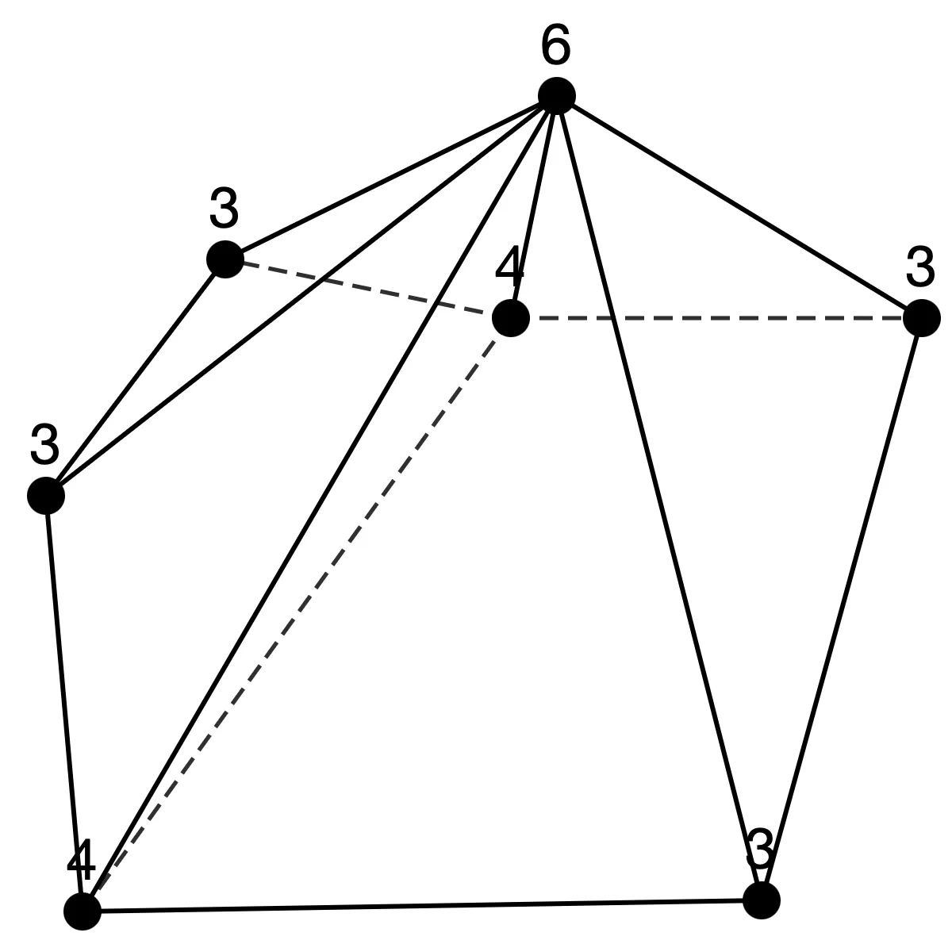
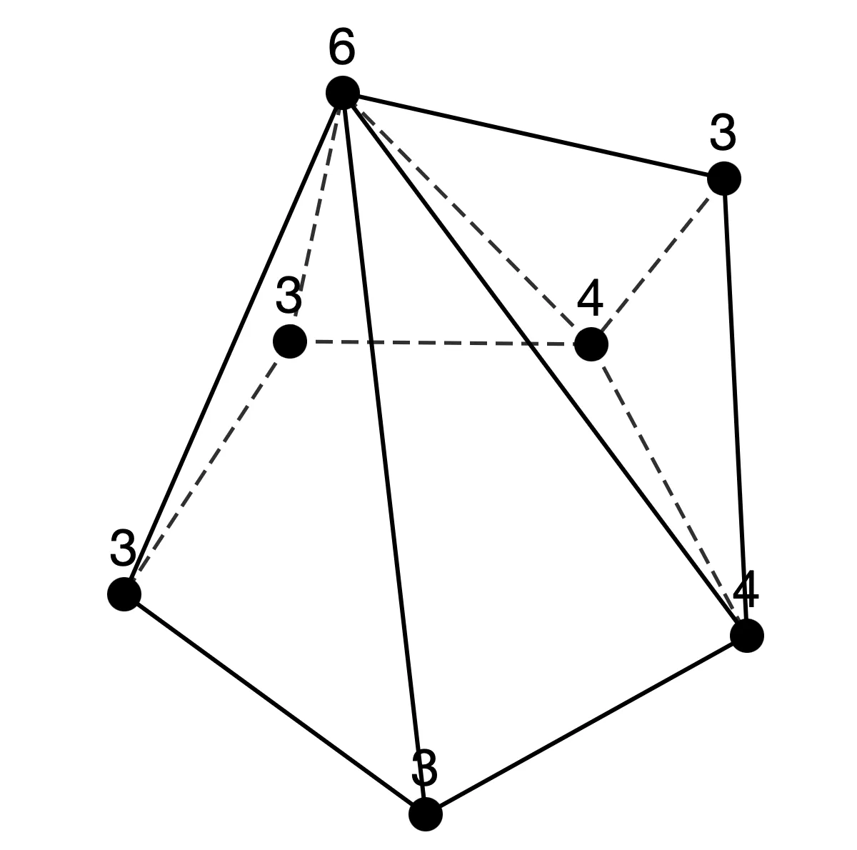
Sequence 1
n=6: [3,3][4,2][5,1]
n=7: [3,4][4,2][6,1]
n=8: [3,5][4,2][7,1]
n=9: [3,6][4,2][8,1]
n=10: [3,7][4,2][9,1]
n=11: [3,8][4,2][10,1]
n = 6 (1 type)
n = 7 (2 types)

Slide 16
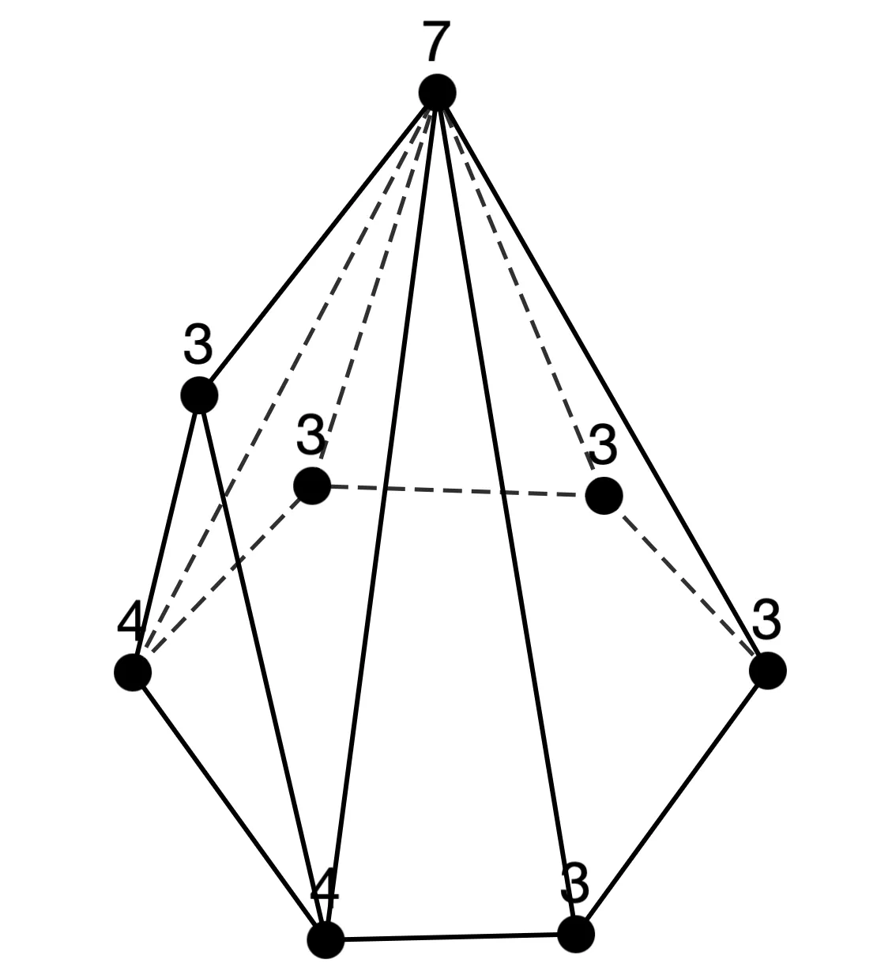
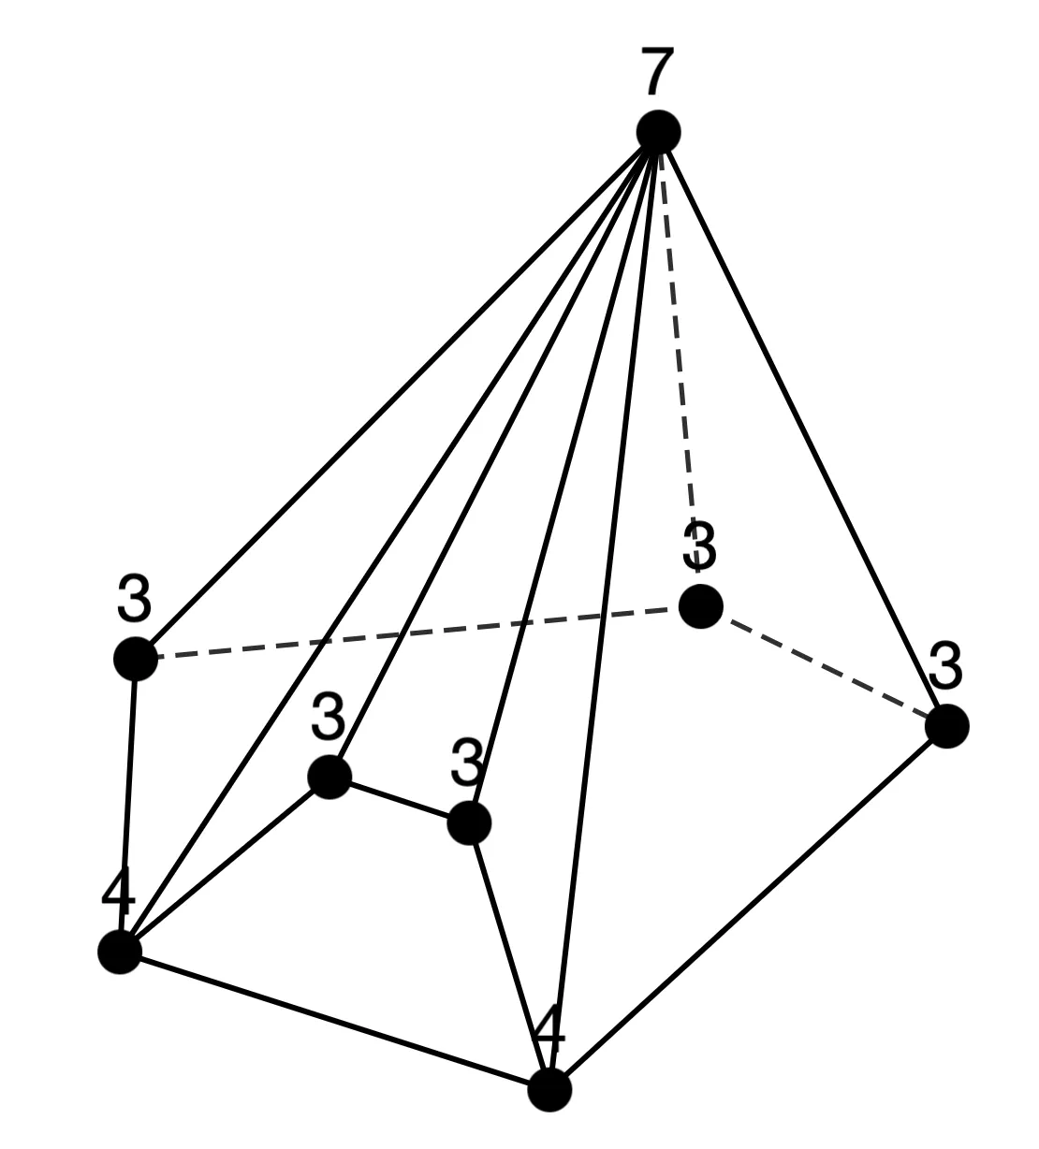
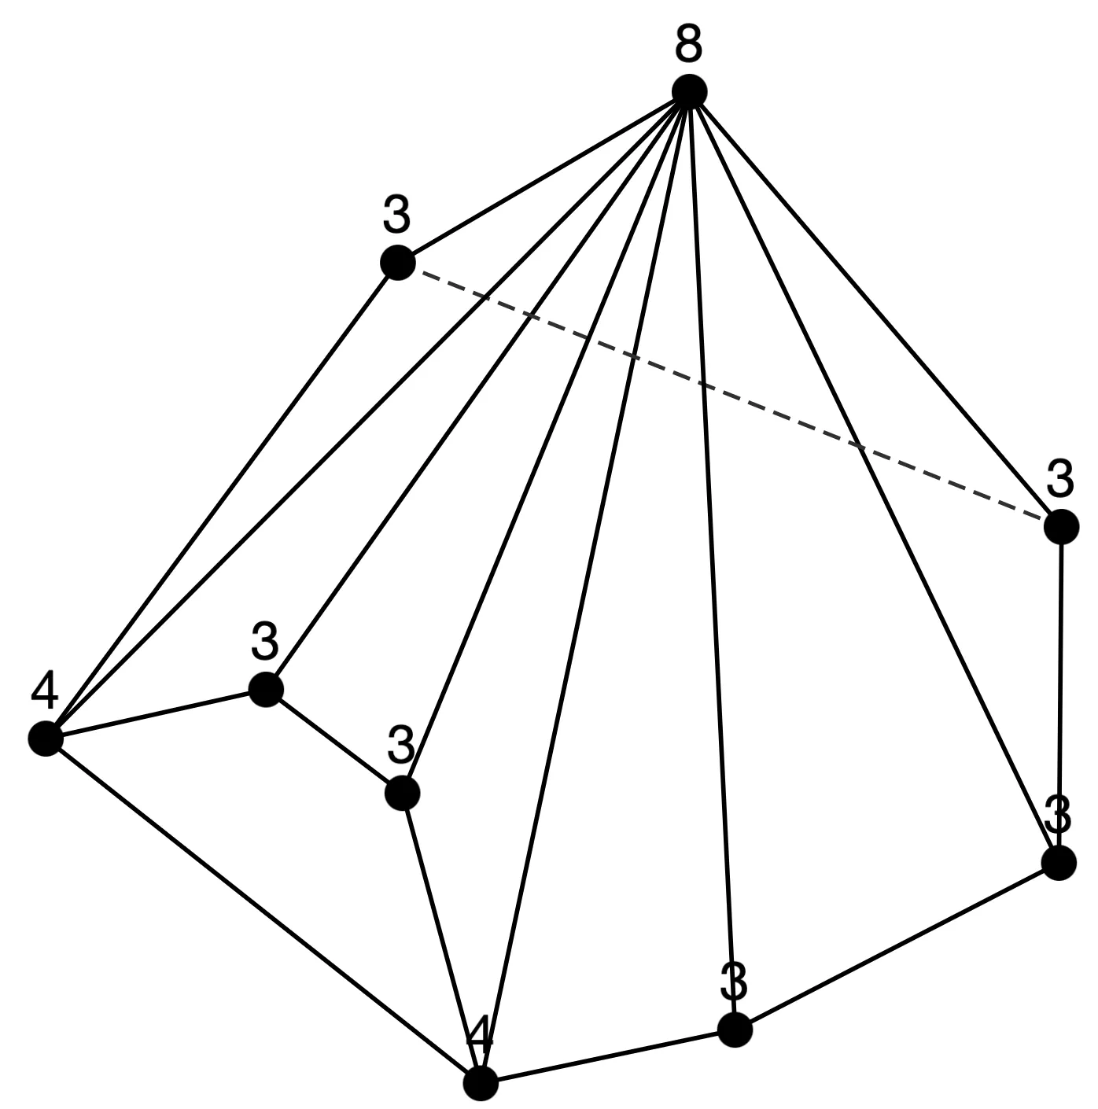
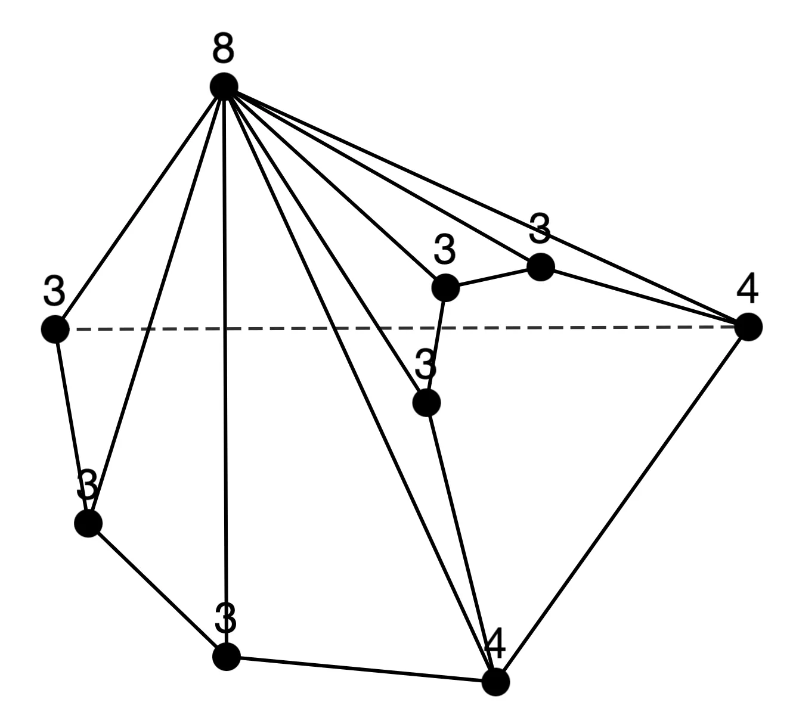
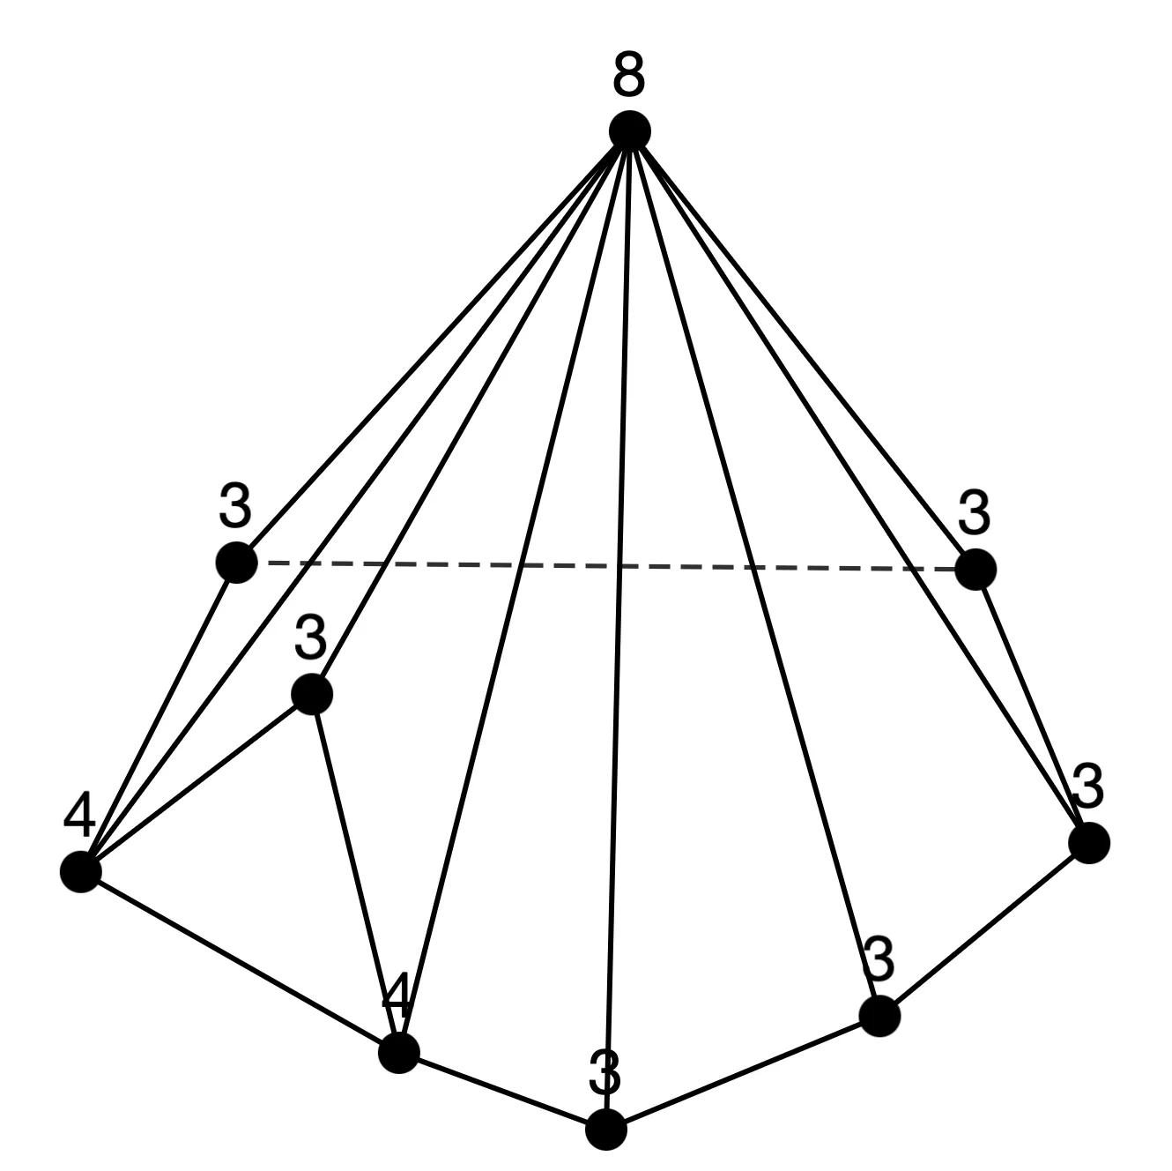
Sequence 1
n = 8 (2 types)
n = 9 (3 types)

Slide 17
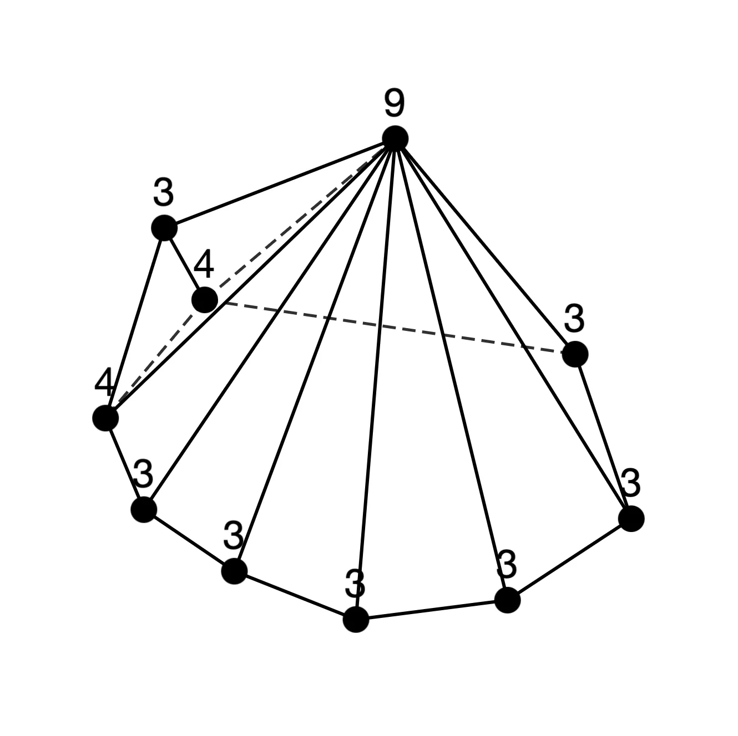
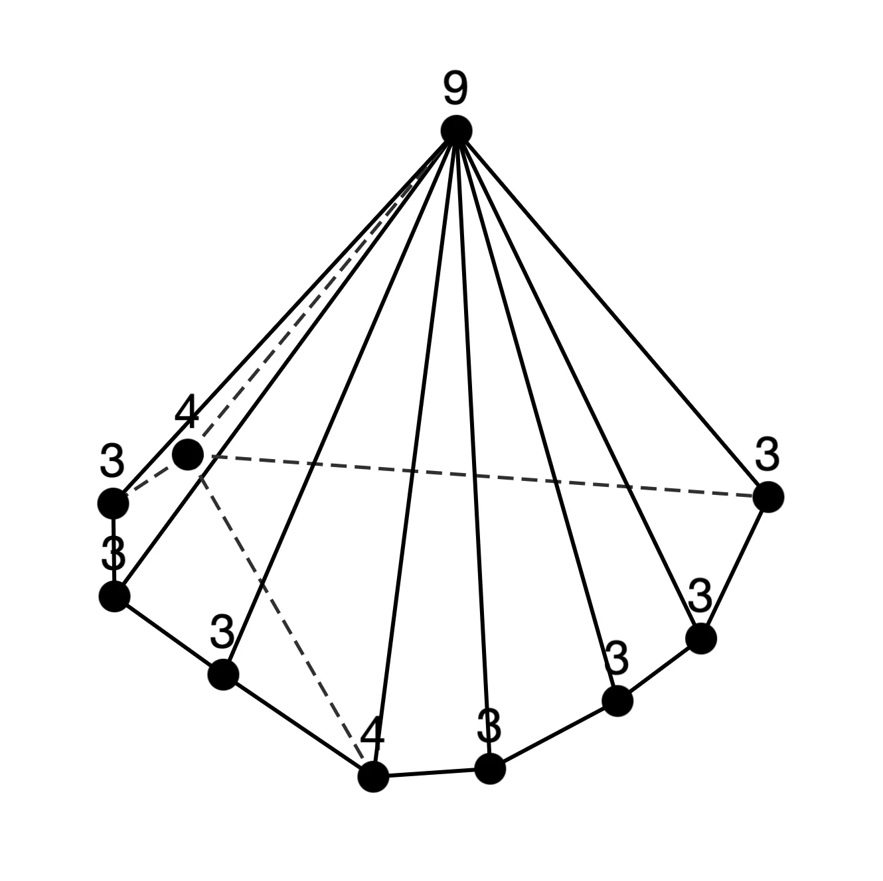
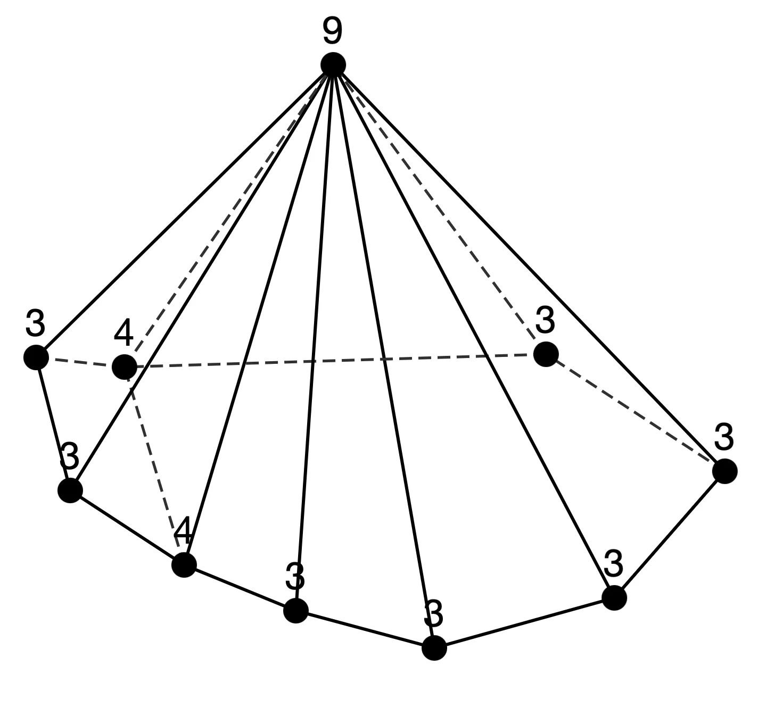
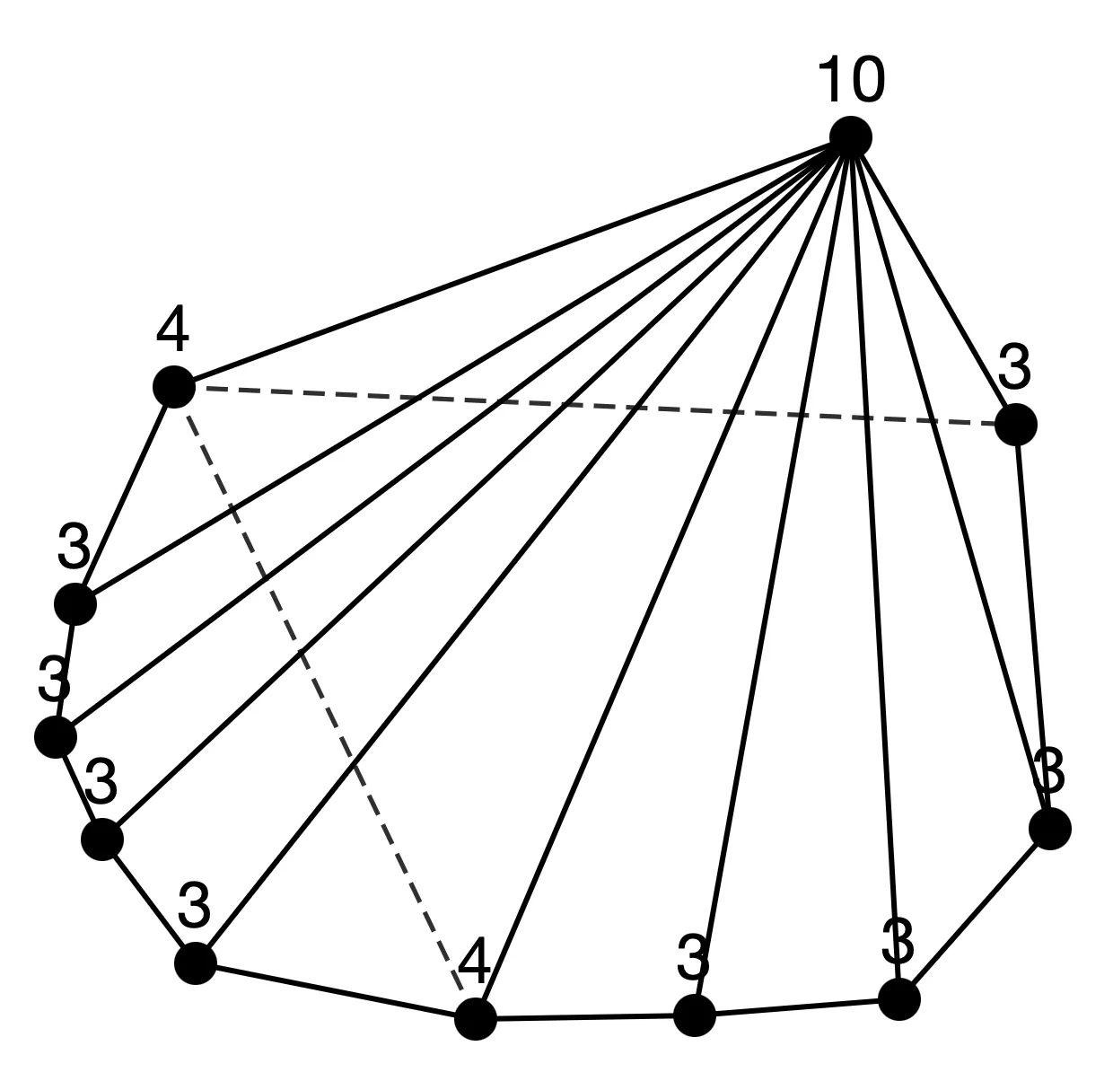
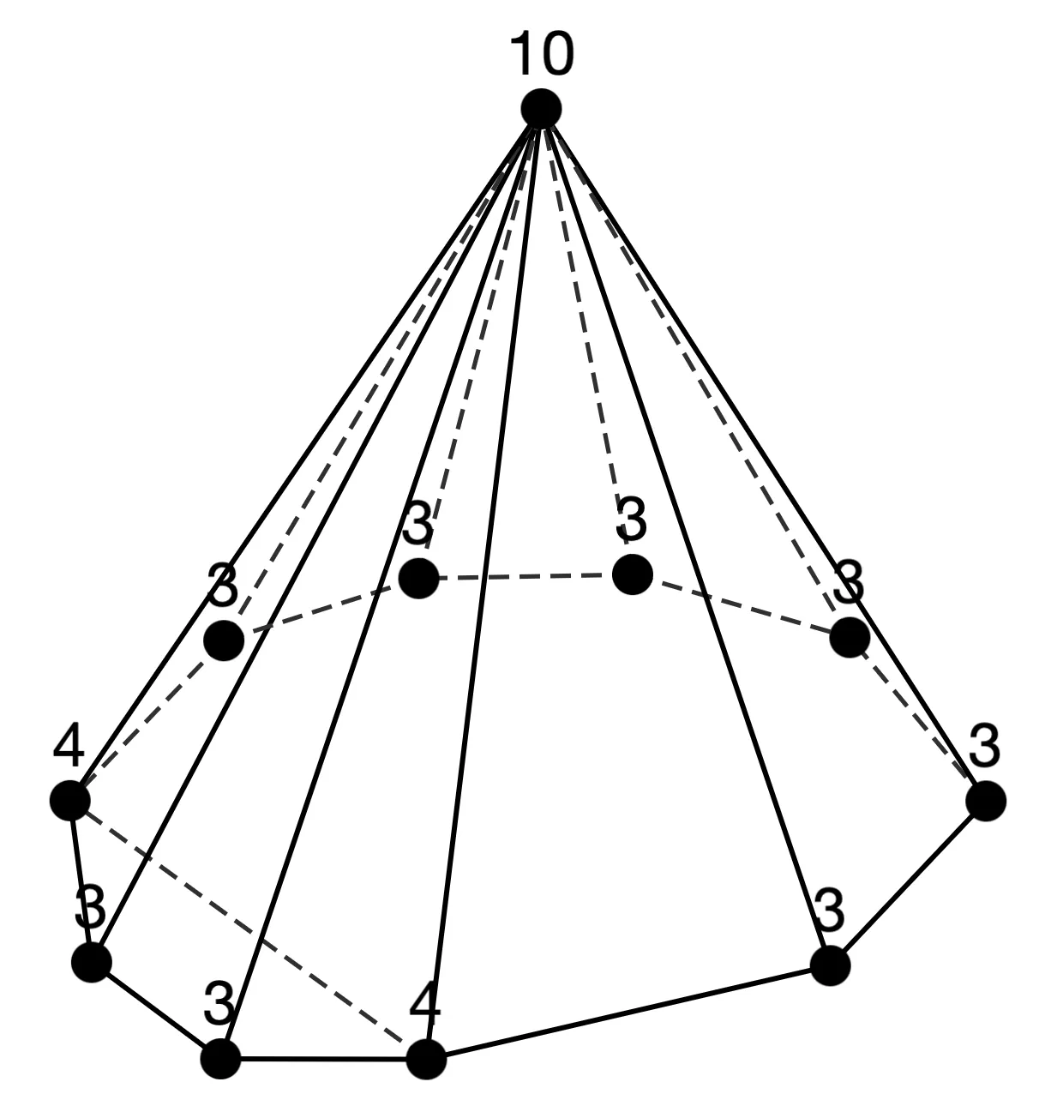
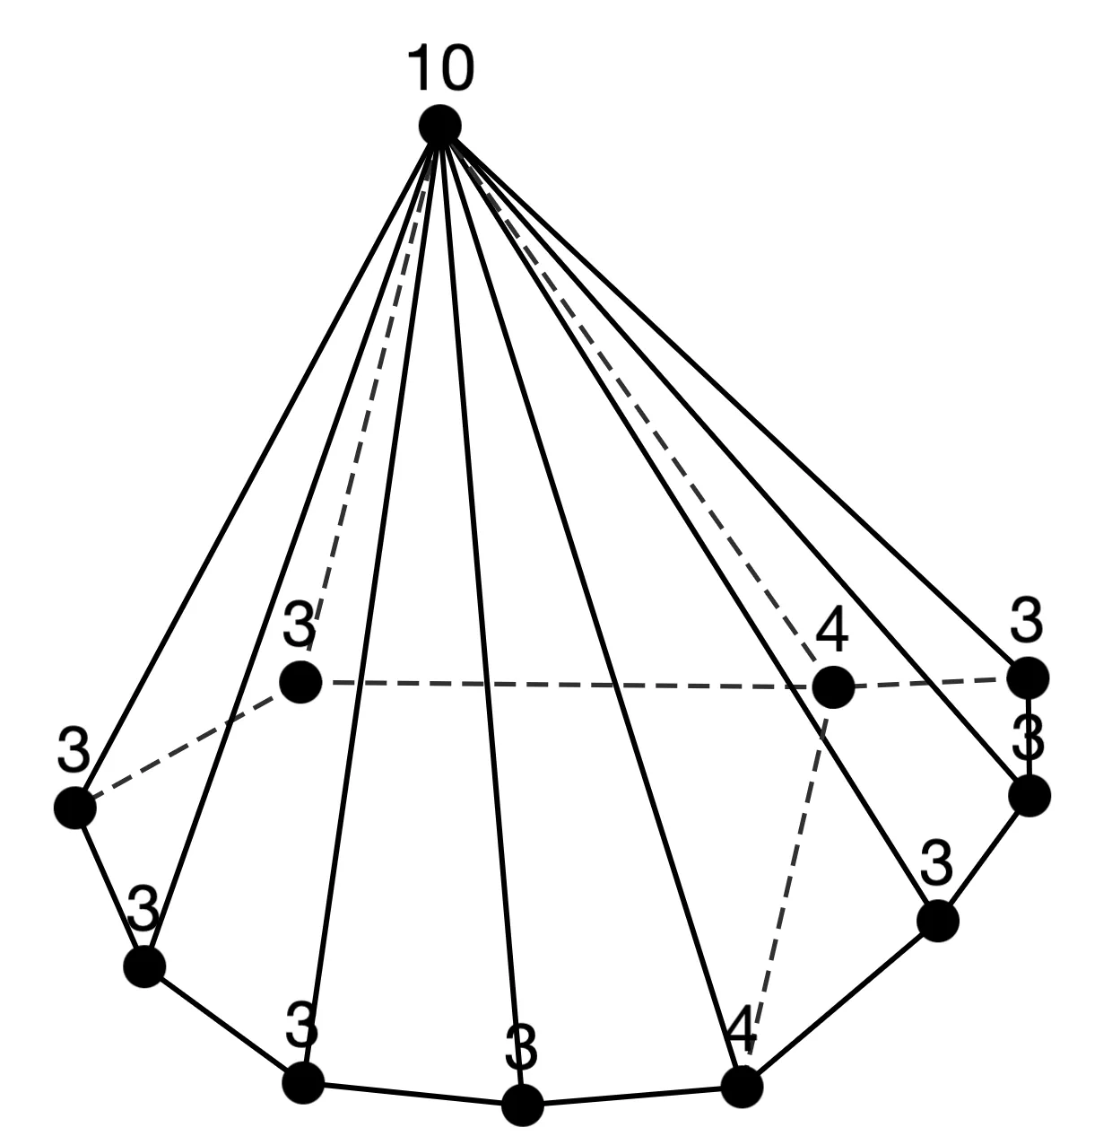
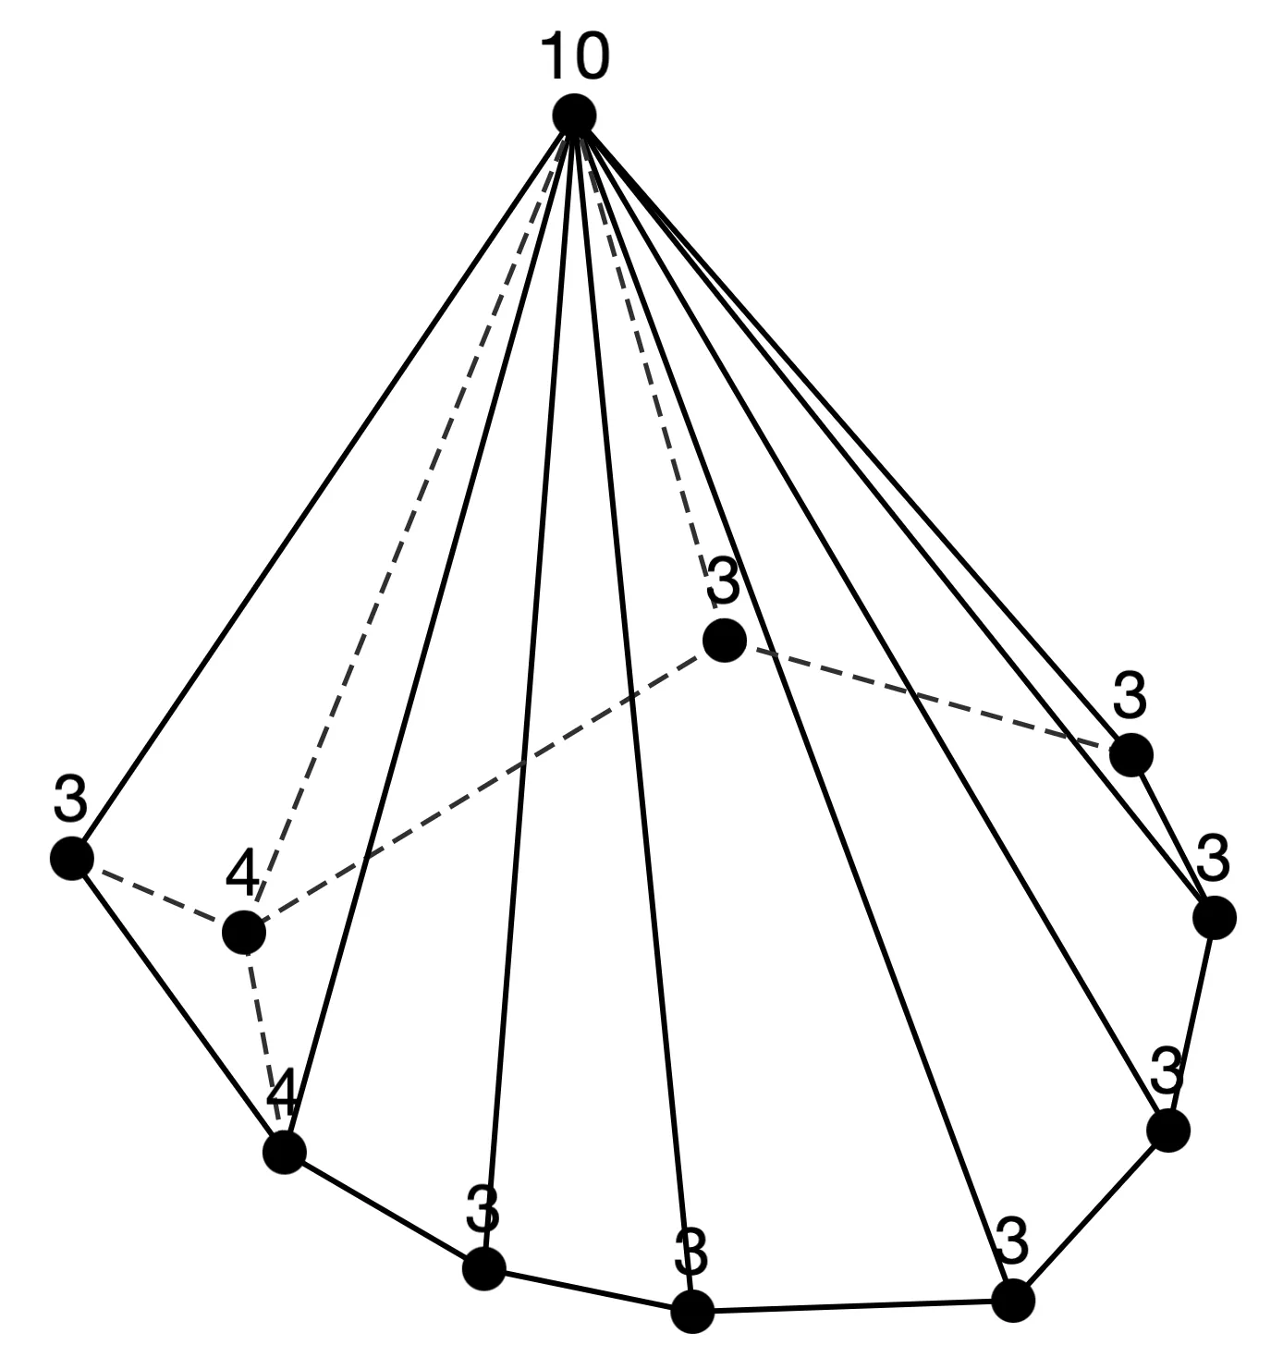
Sequence 1
n = 10 (3 types)
n = 11 (4 types)

Slide 18
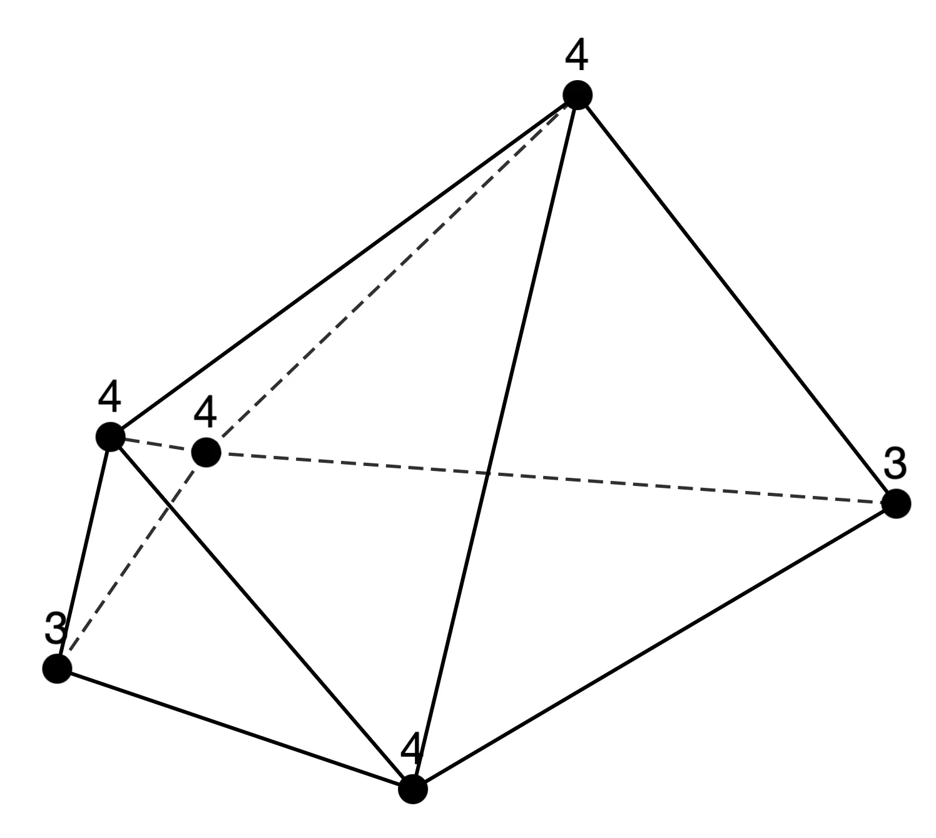
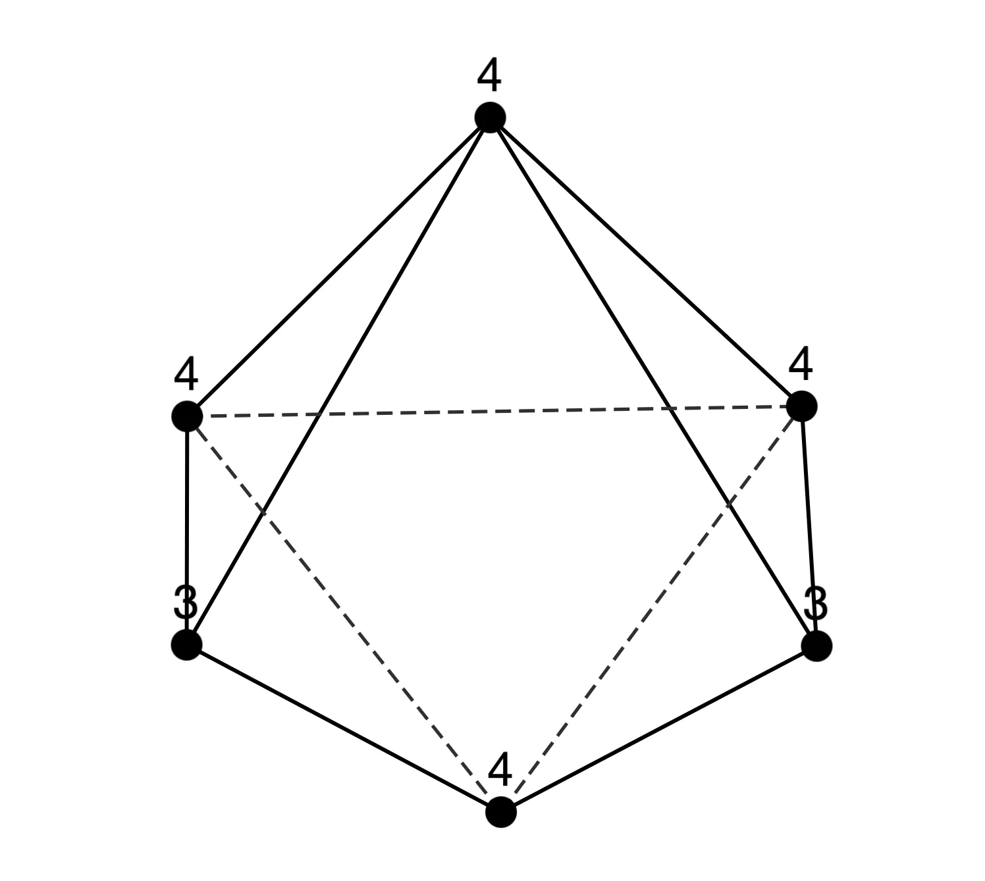
Sequence 2
n=6: [3,2][4,3][4,1] (=[3,2][4,4])
n=7: [3,3][4,3][5,1]
n=8: [3,4][4,3][6,1]
n=9: [3,5][4,3][7,1]
n=10: [3,6][4,3][8,1]
n=11: [3,7][4,3][9,1]
n = 6 (1 type)

Slide 19
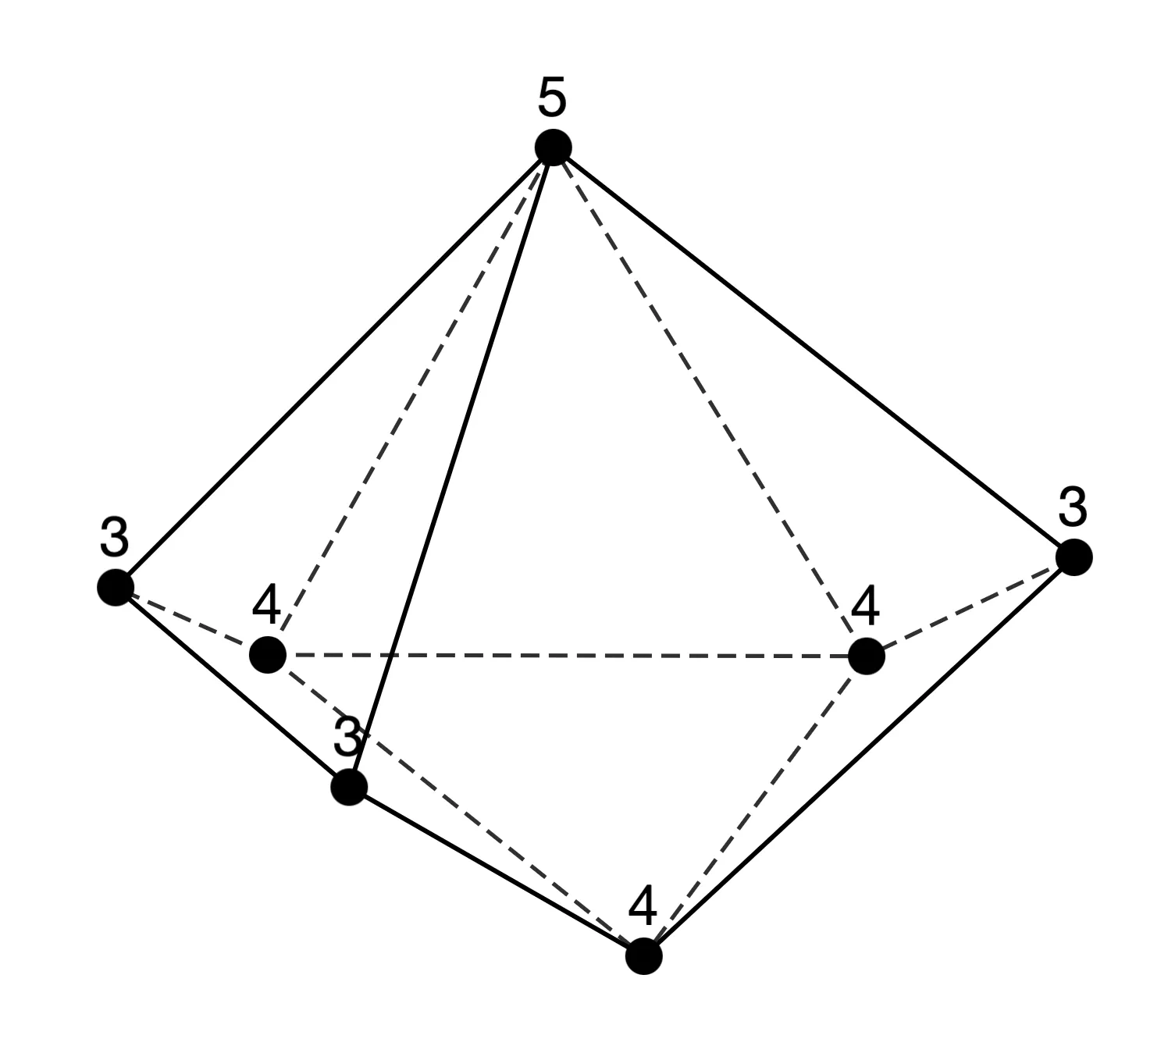
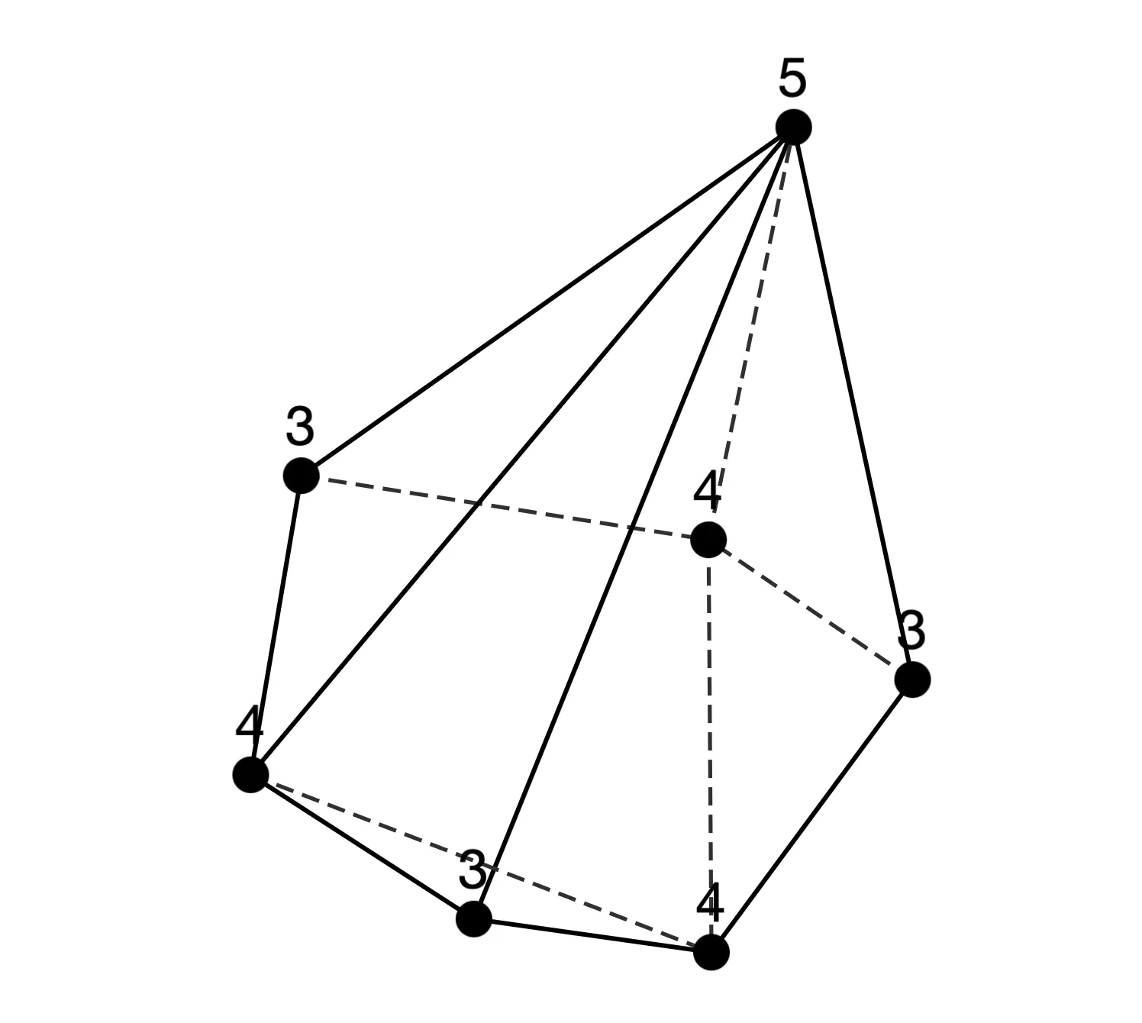
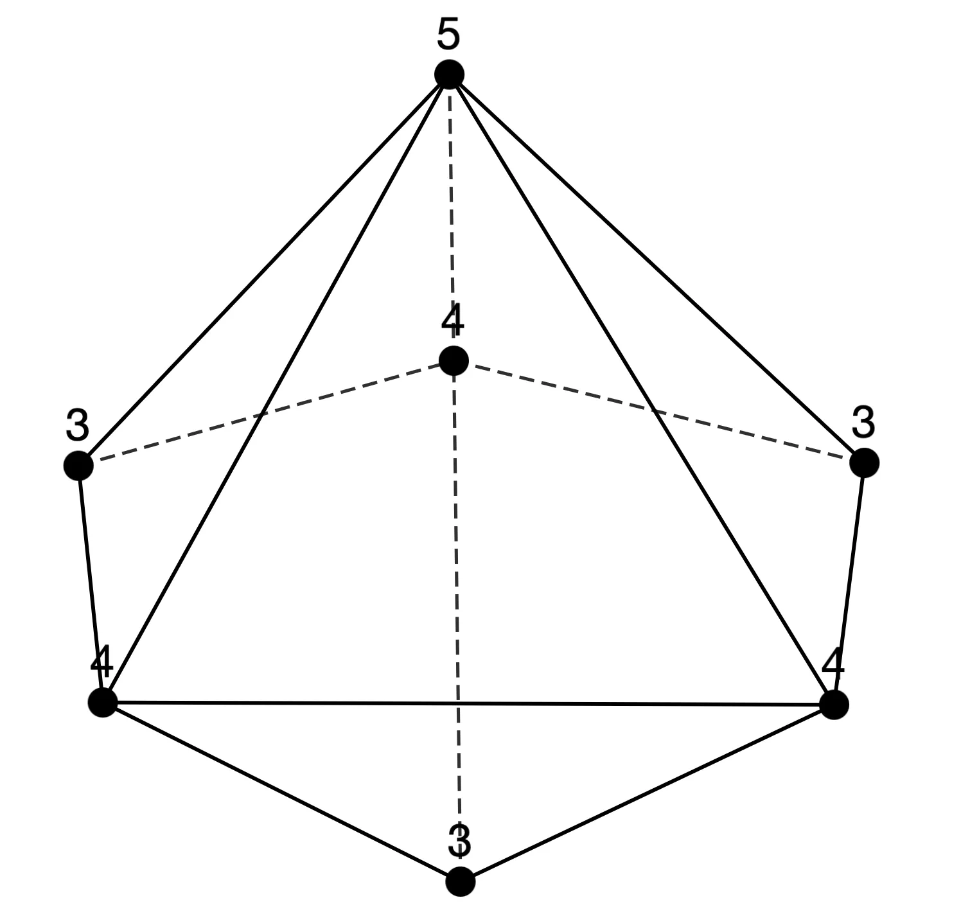
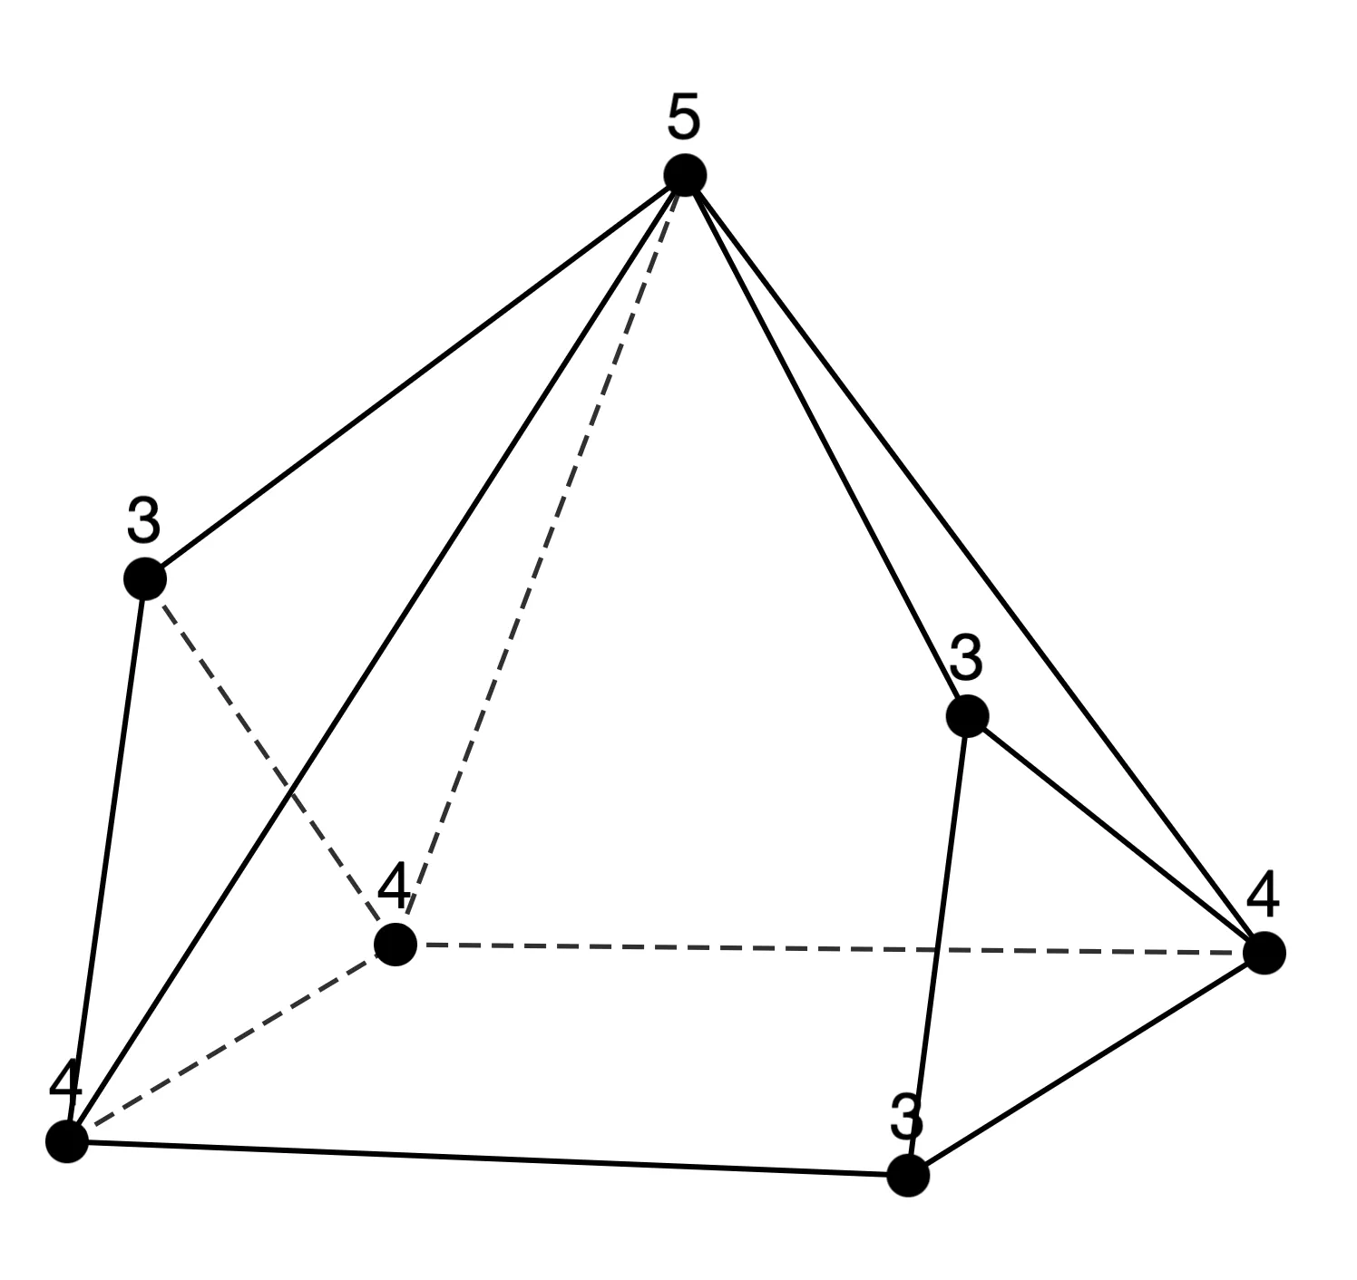
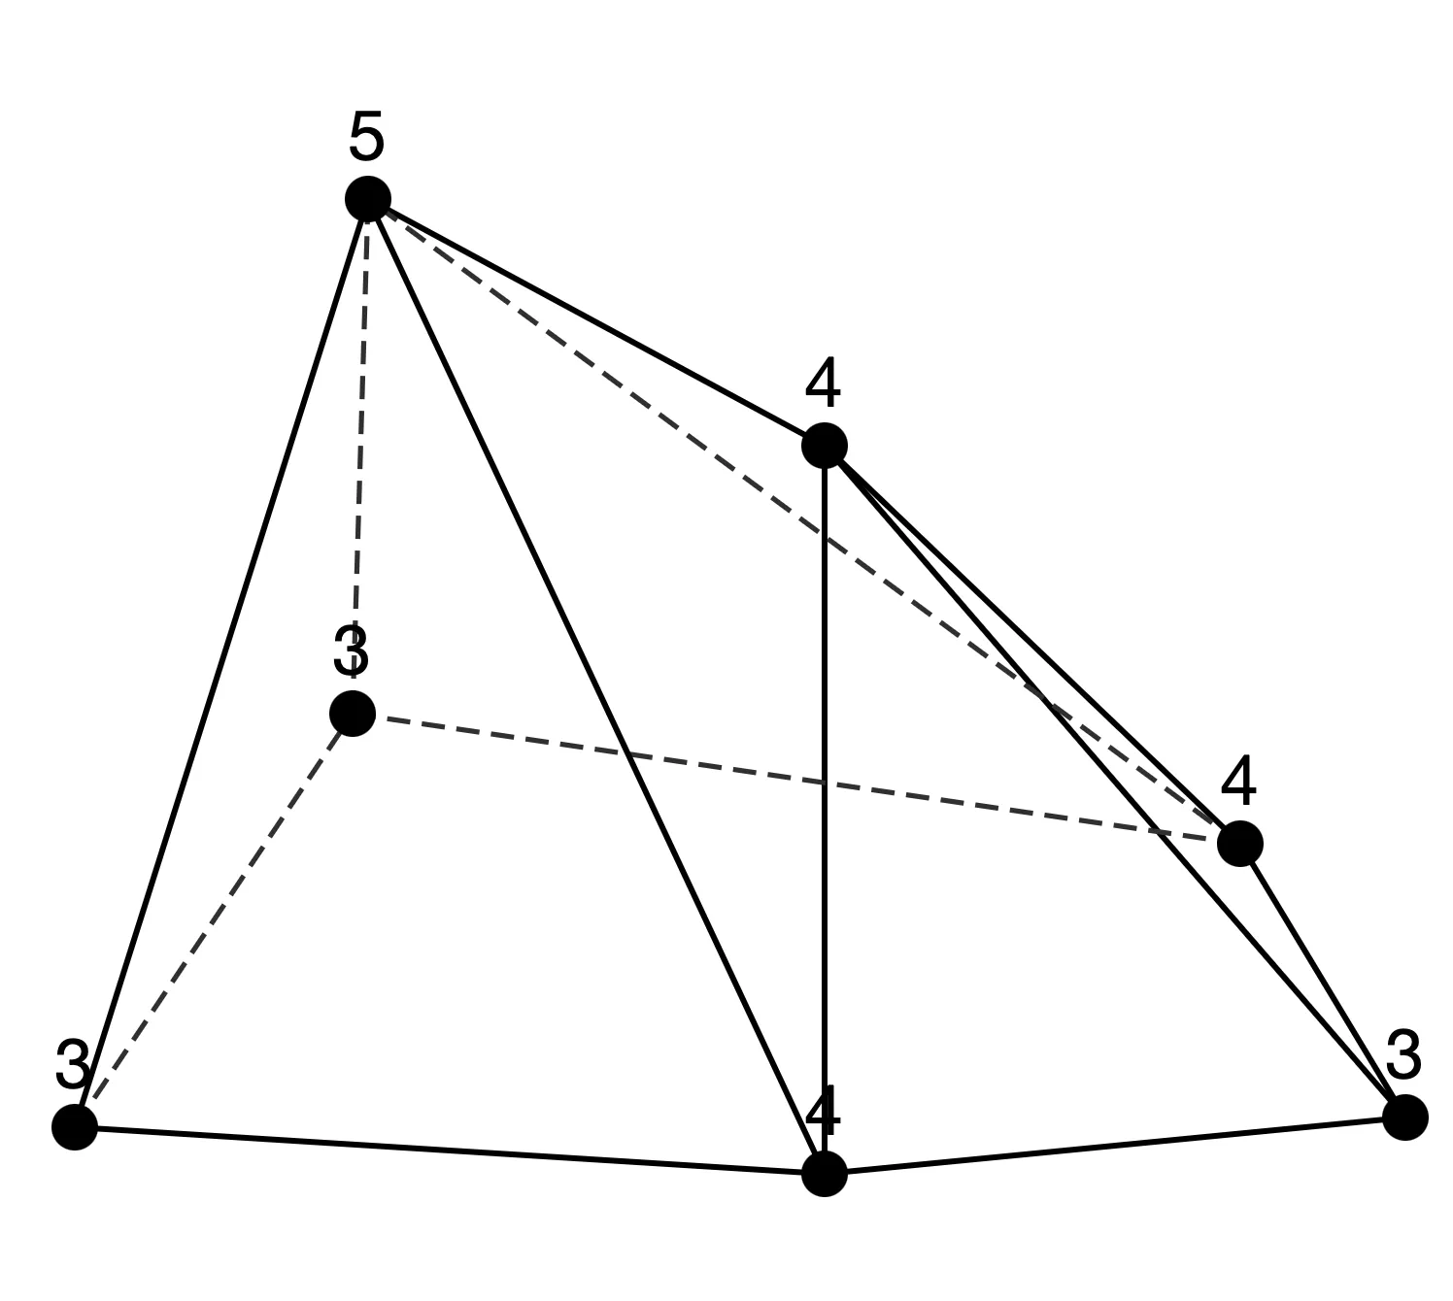
Sequence 2
n = 7 (5 types)

Slide 20
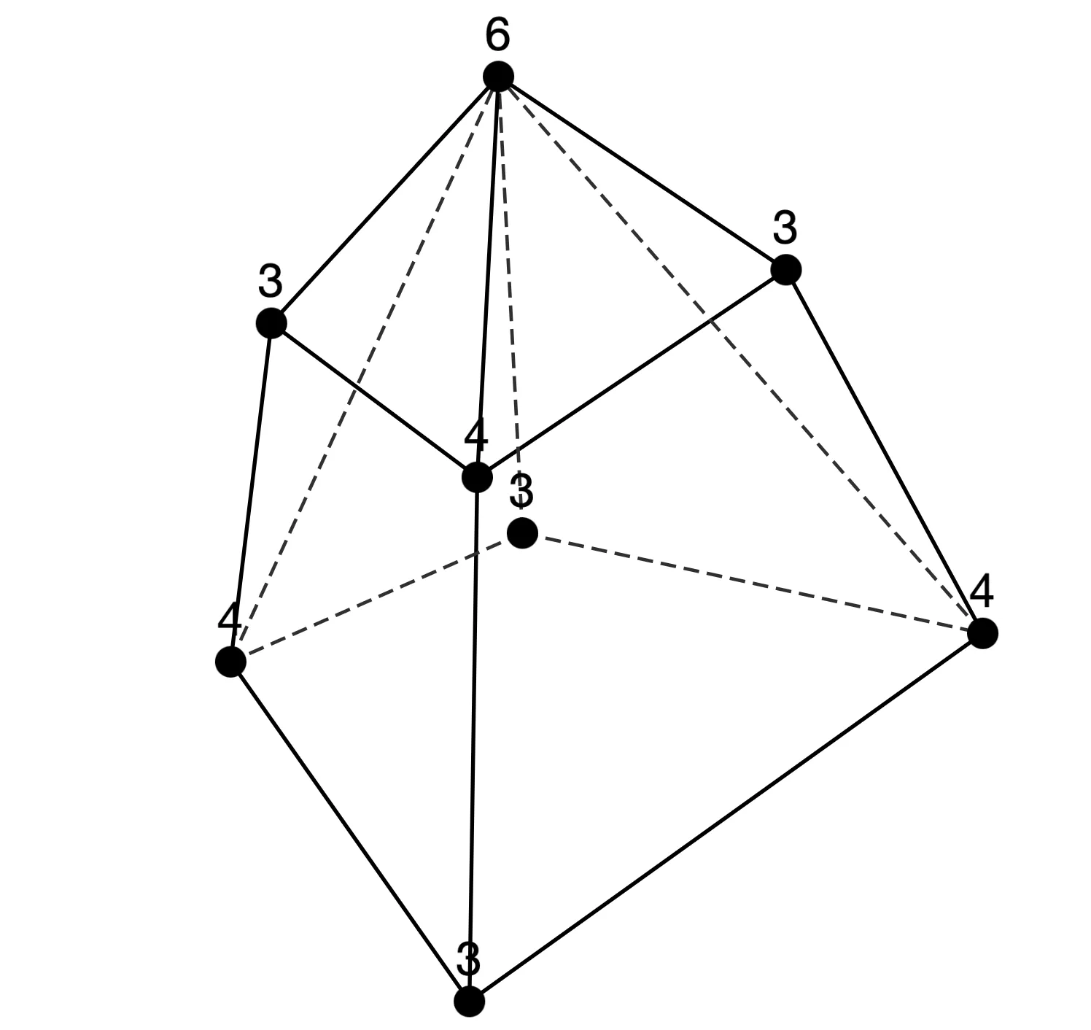
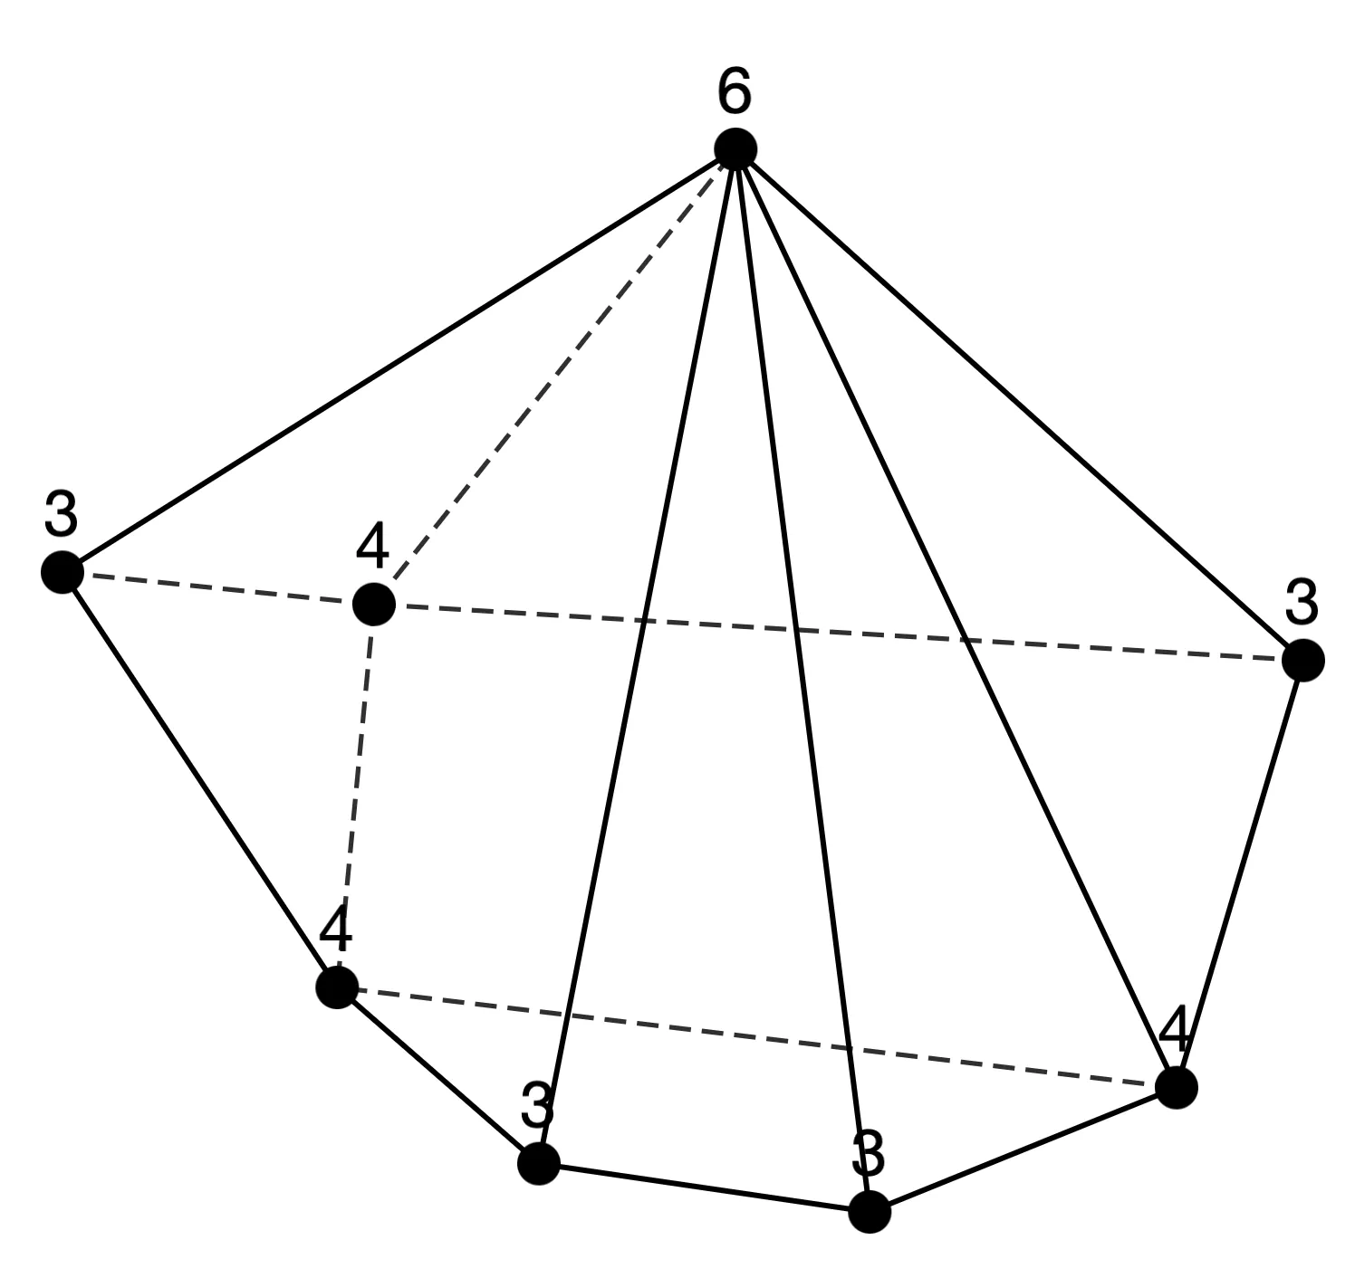
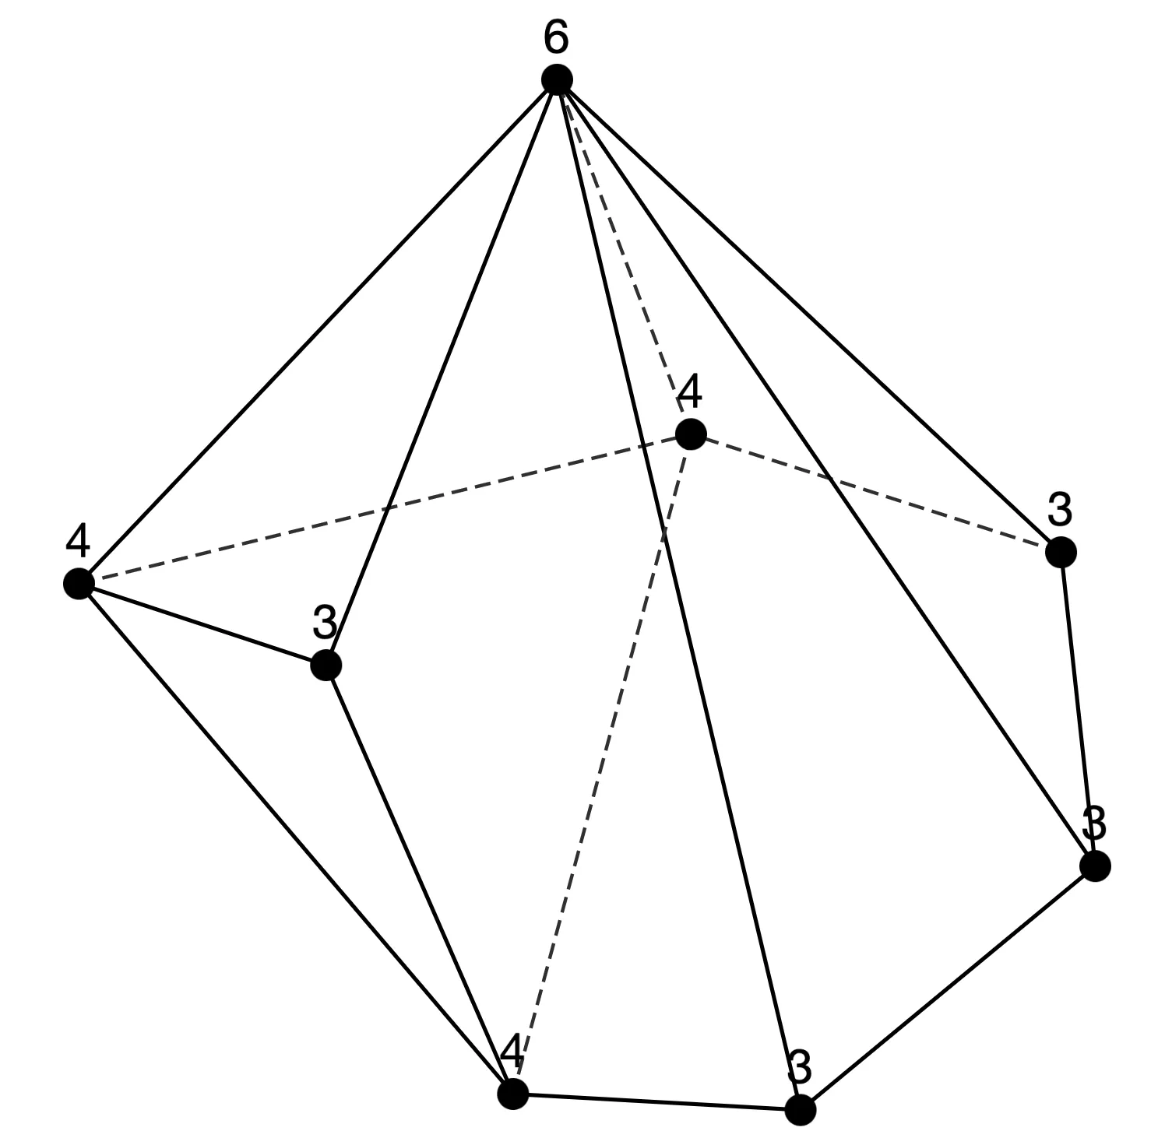
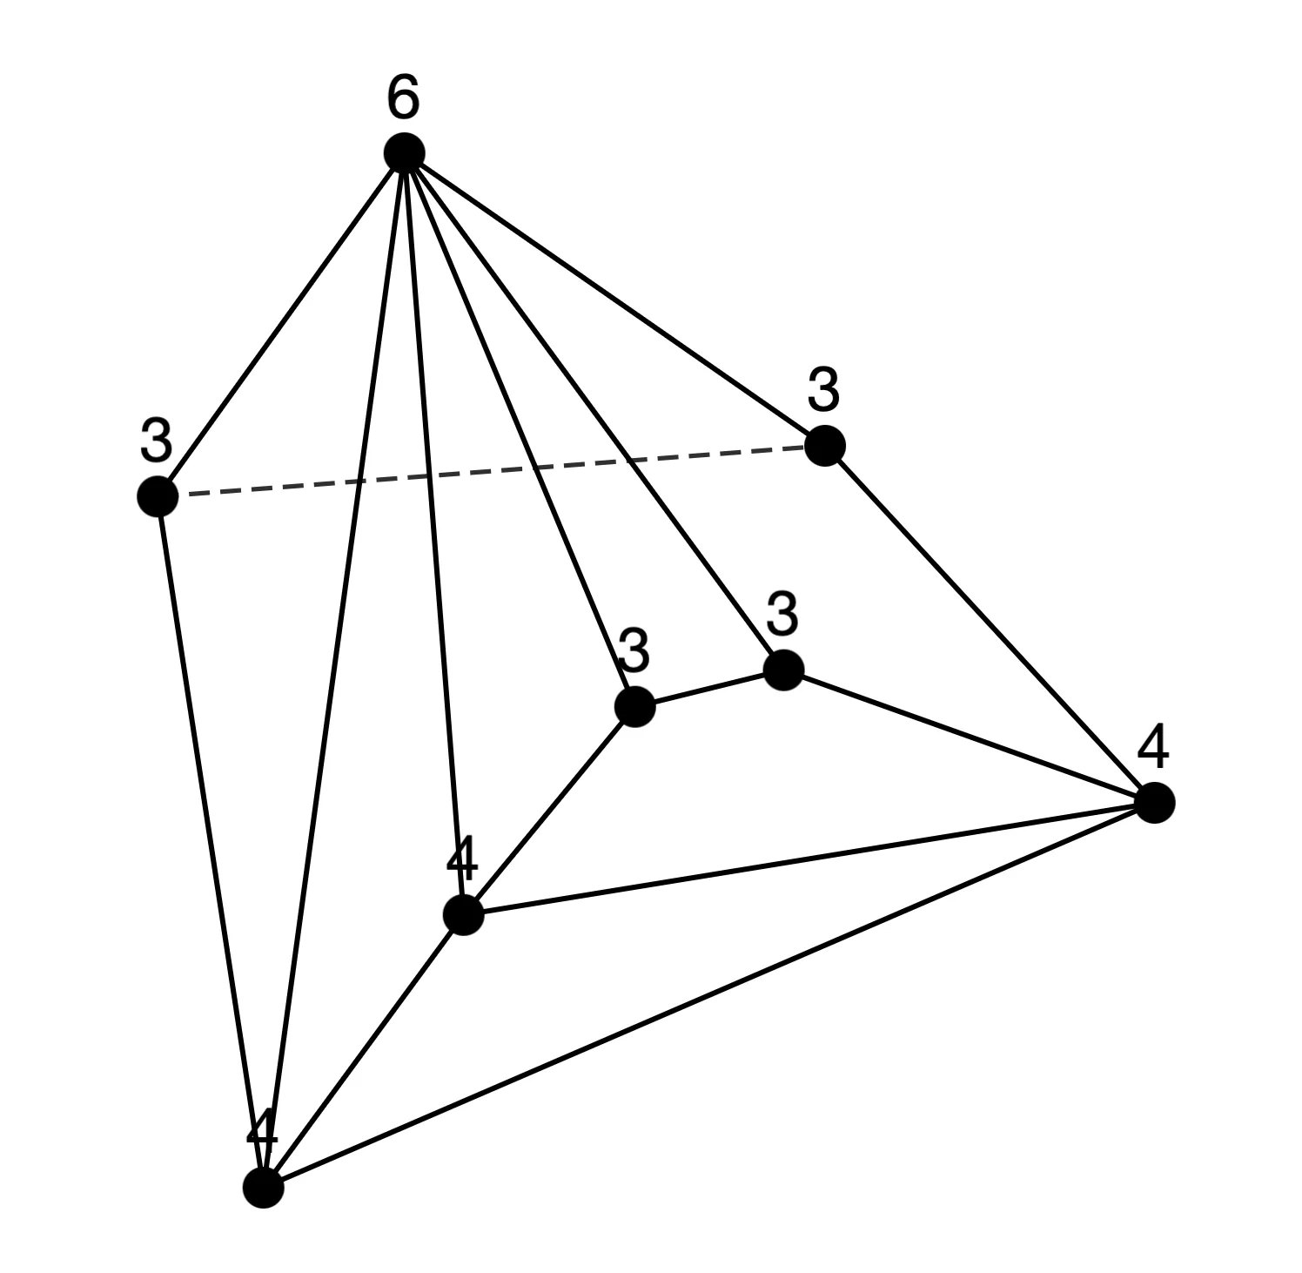
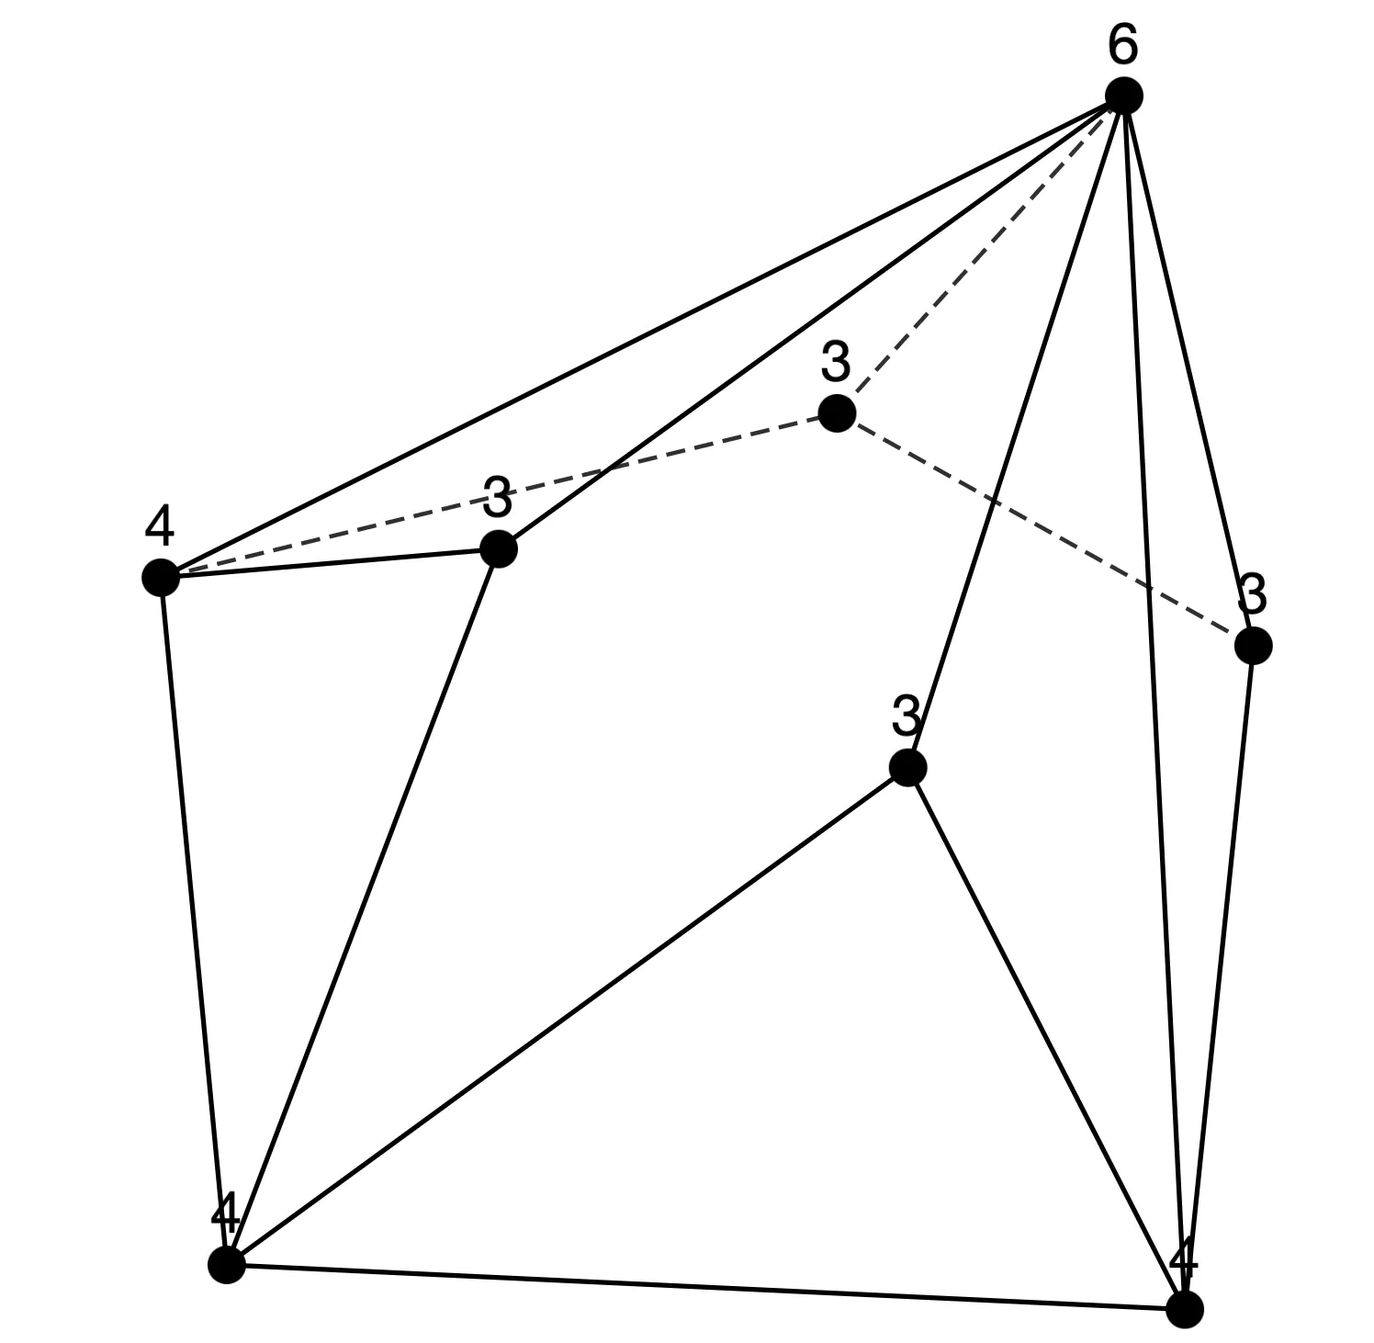
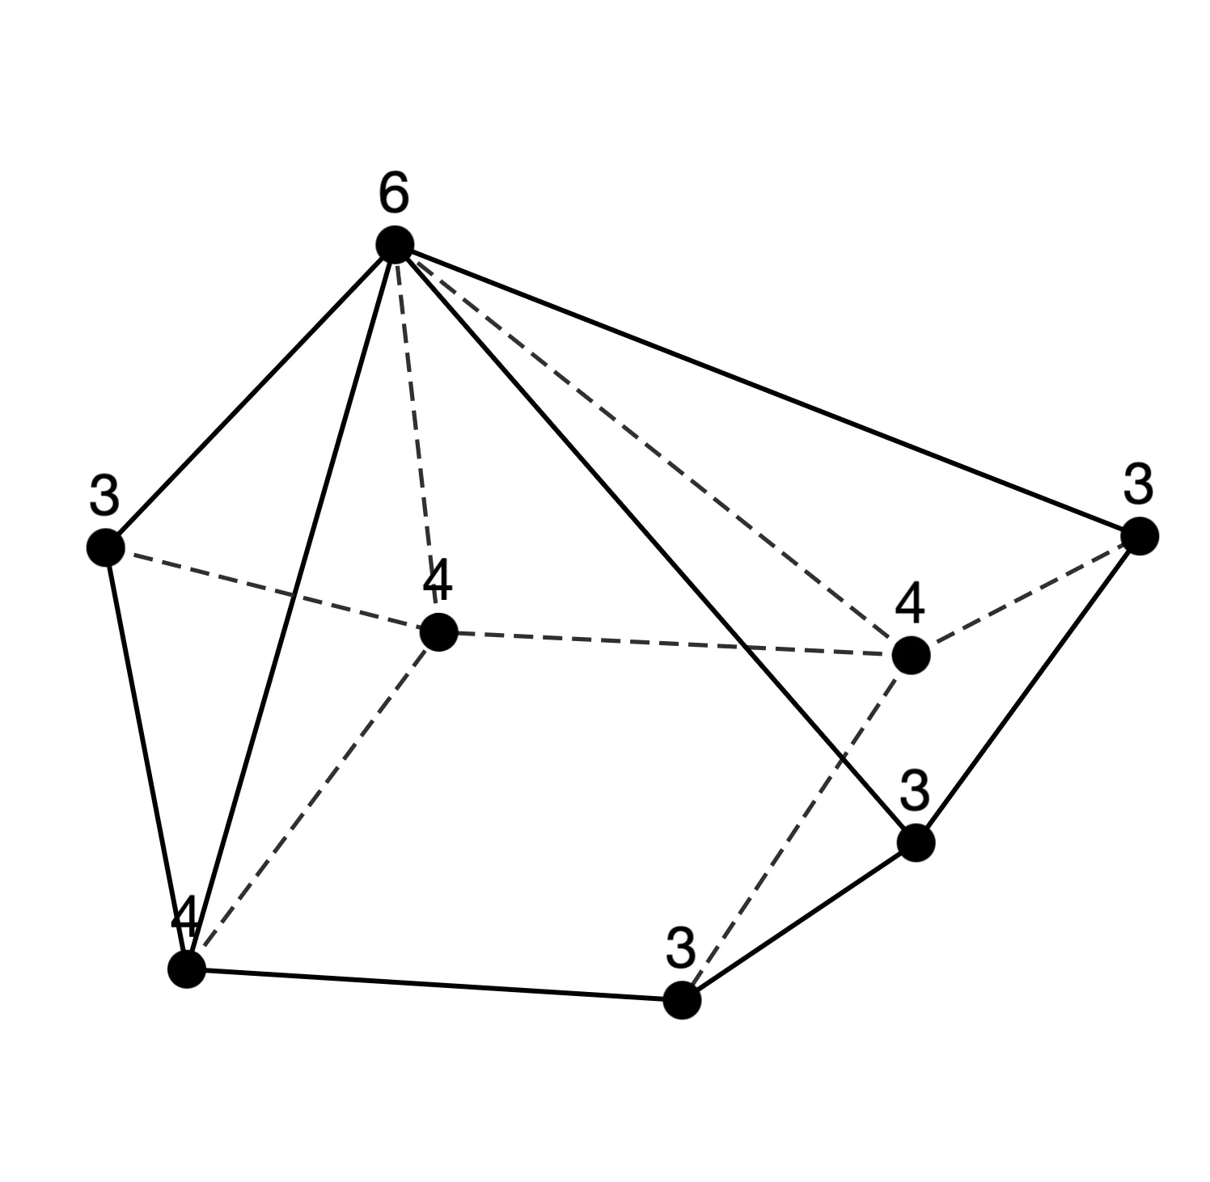
Sequence 2
n = 8 (11 types)

Slide 21
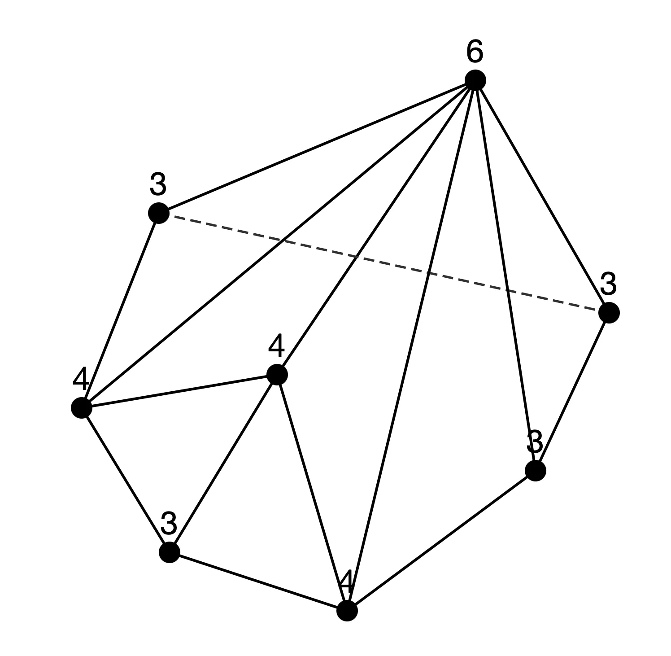
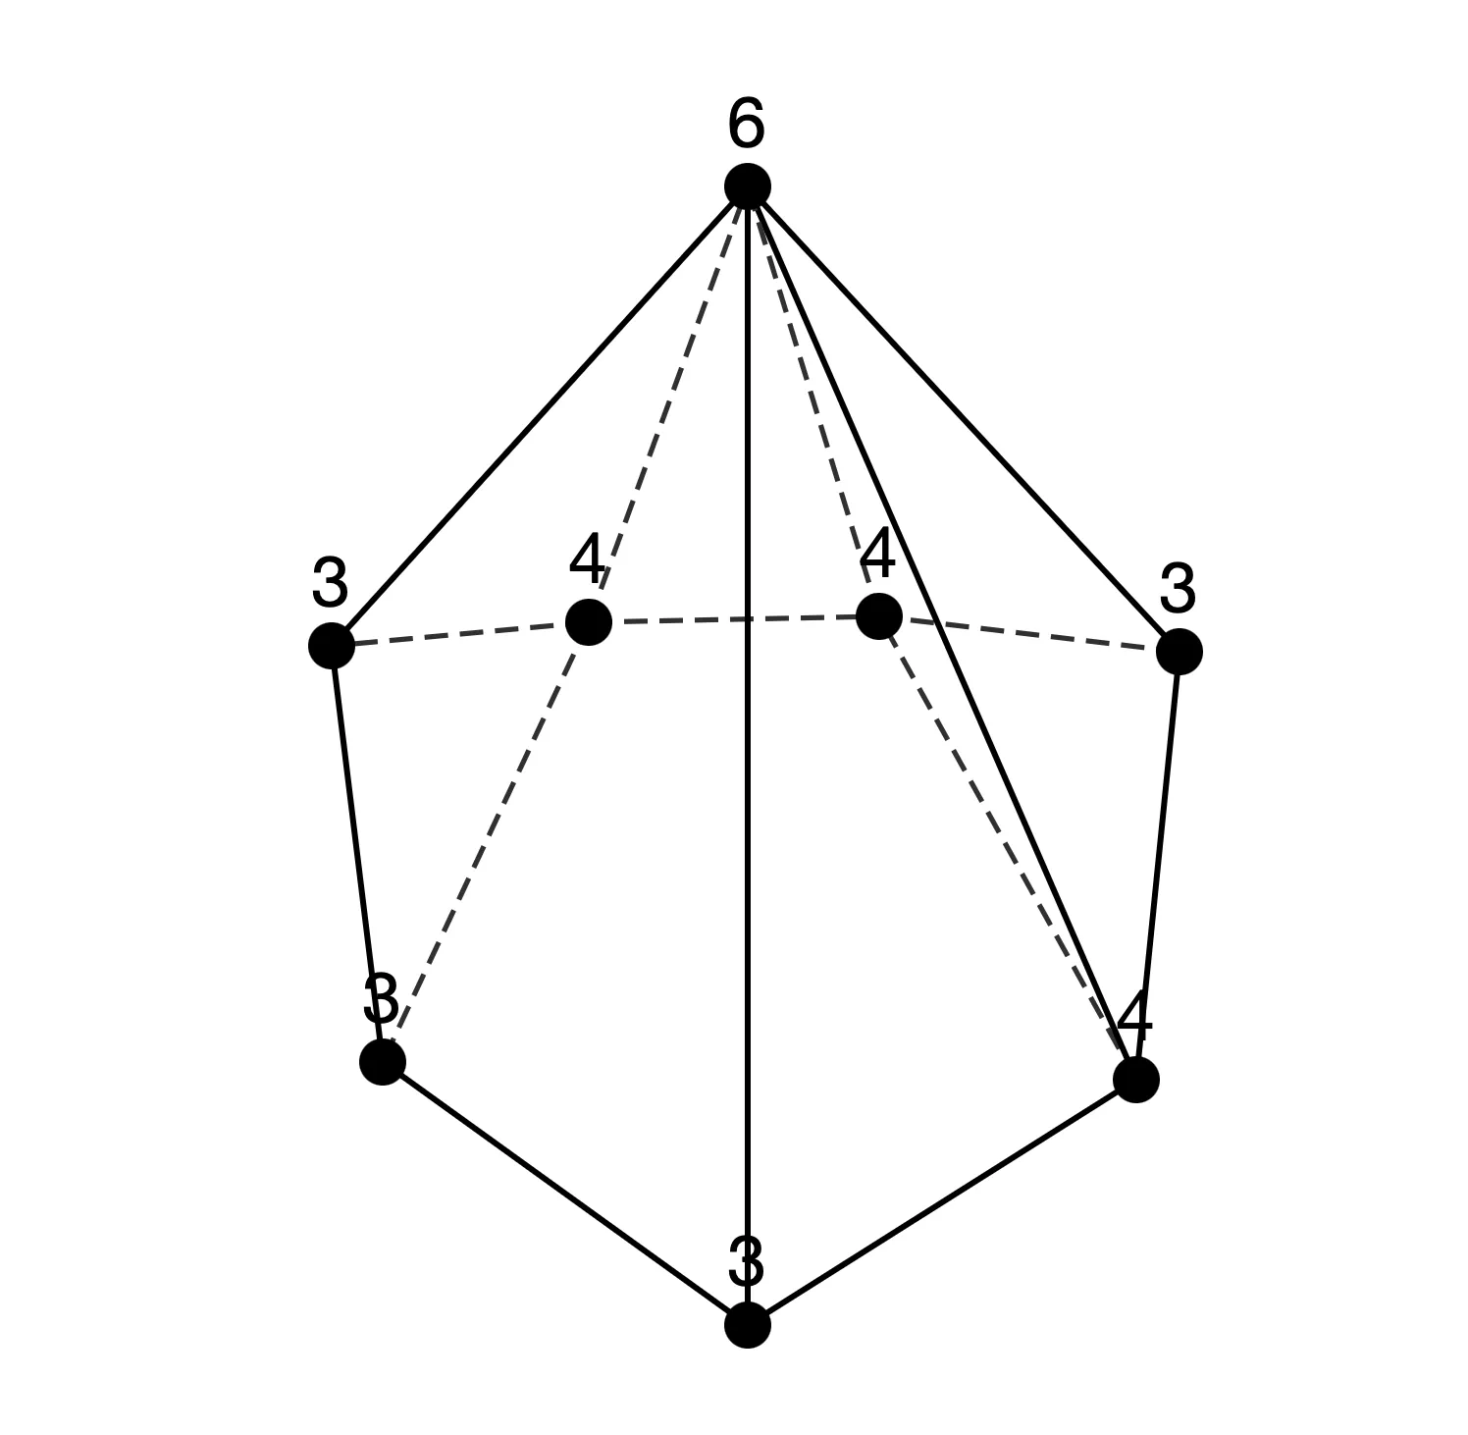
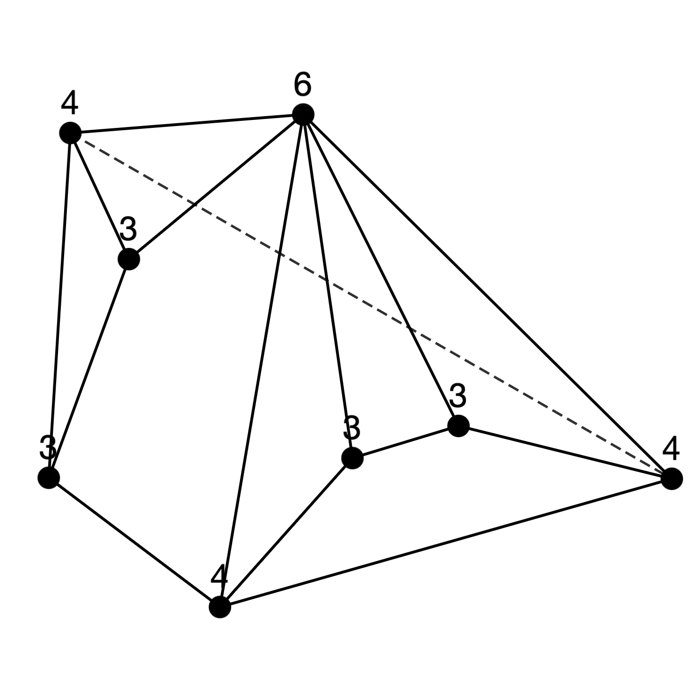
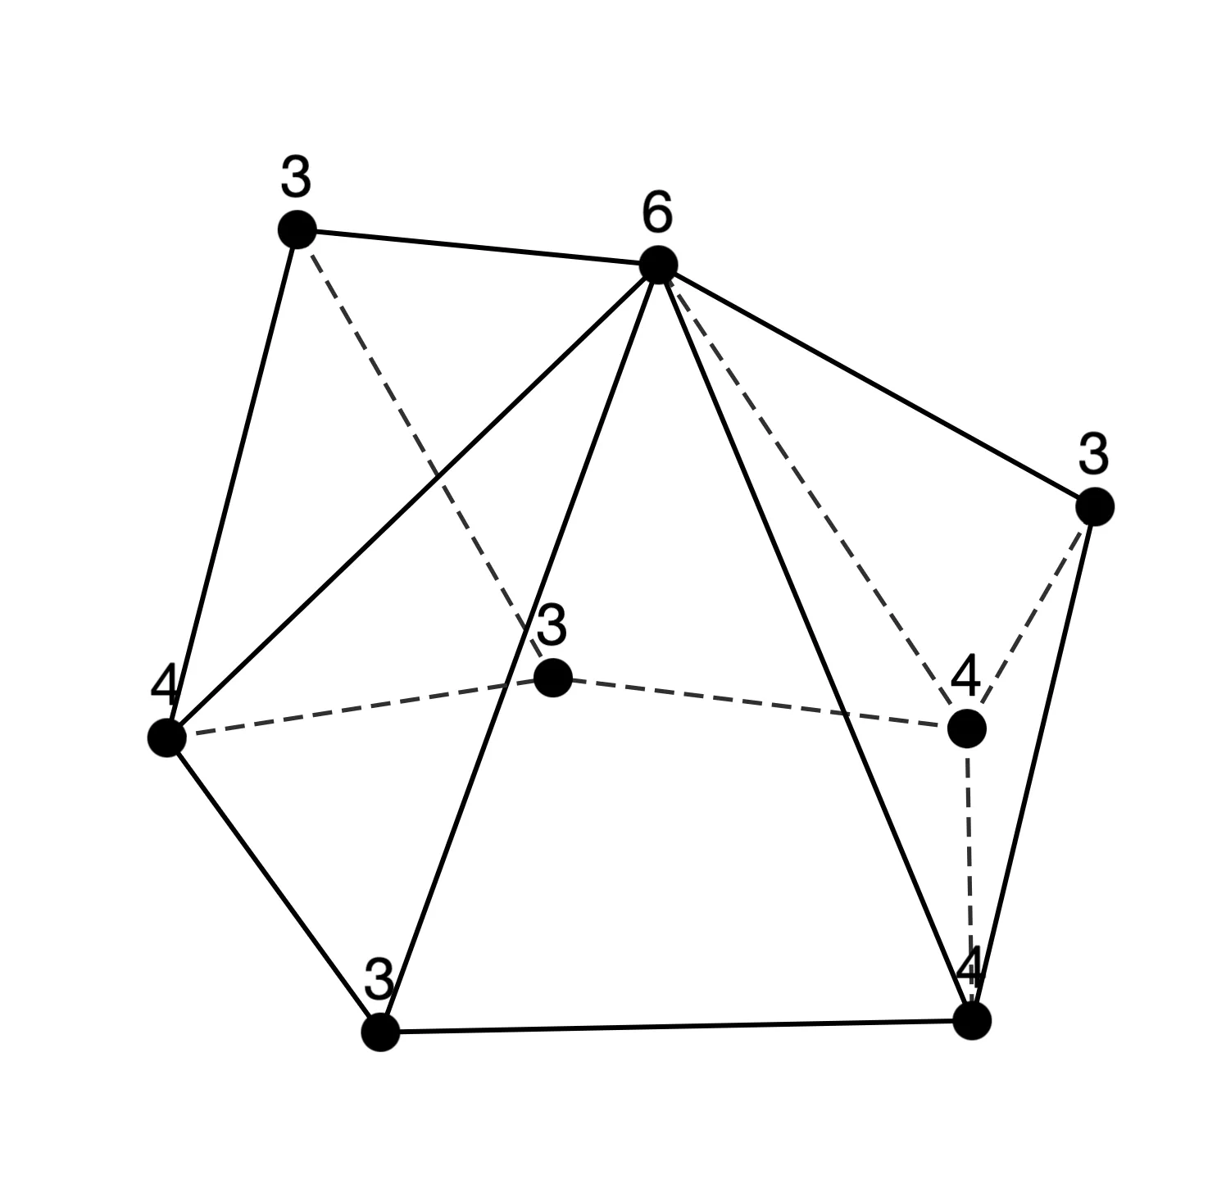
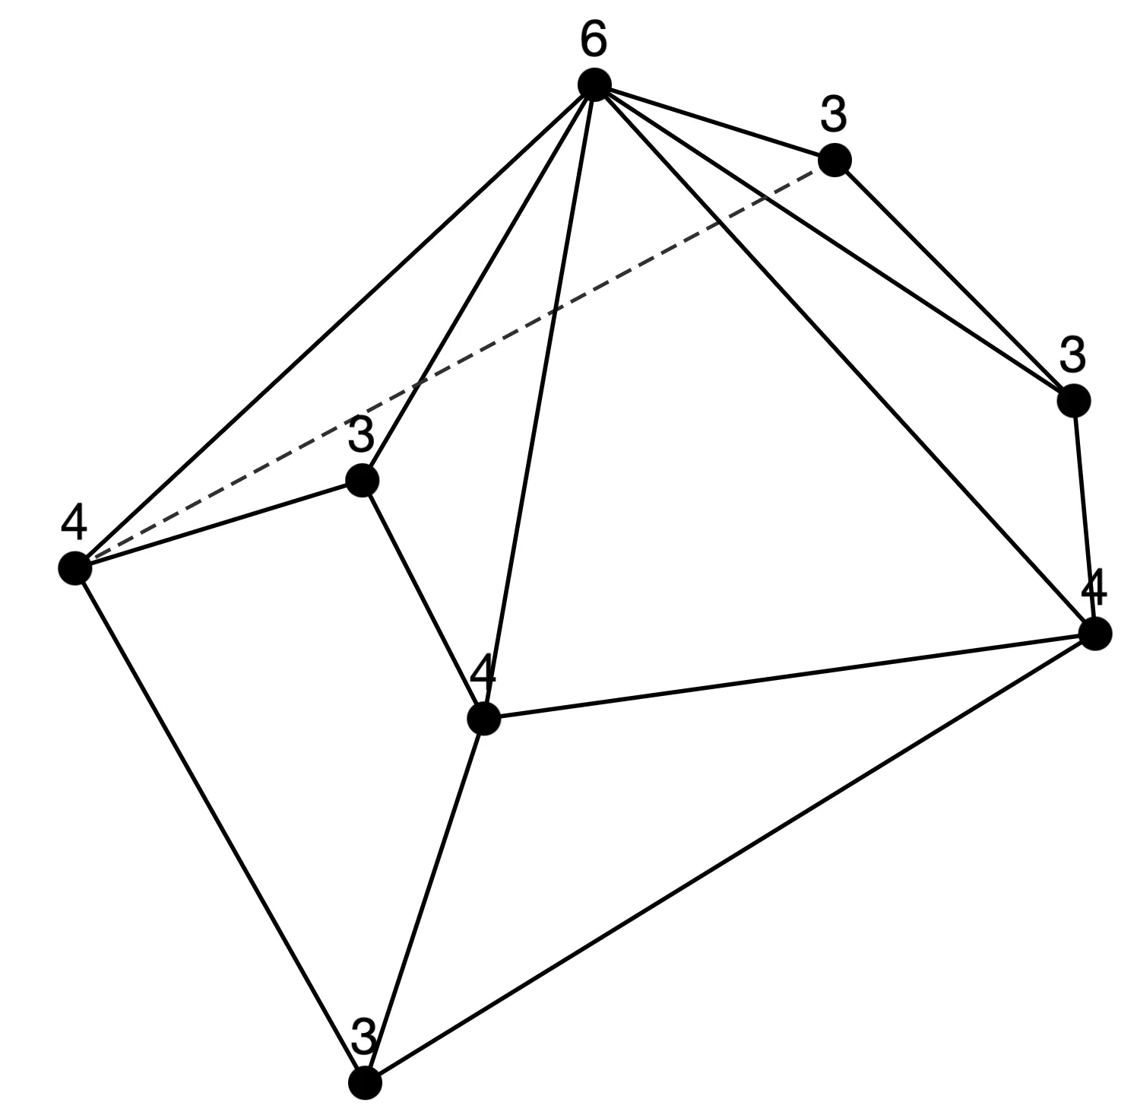
Sequence 2
n = 8 (continued)

Slide 22
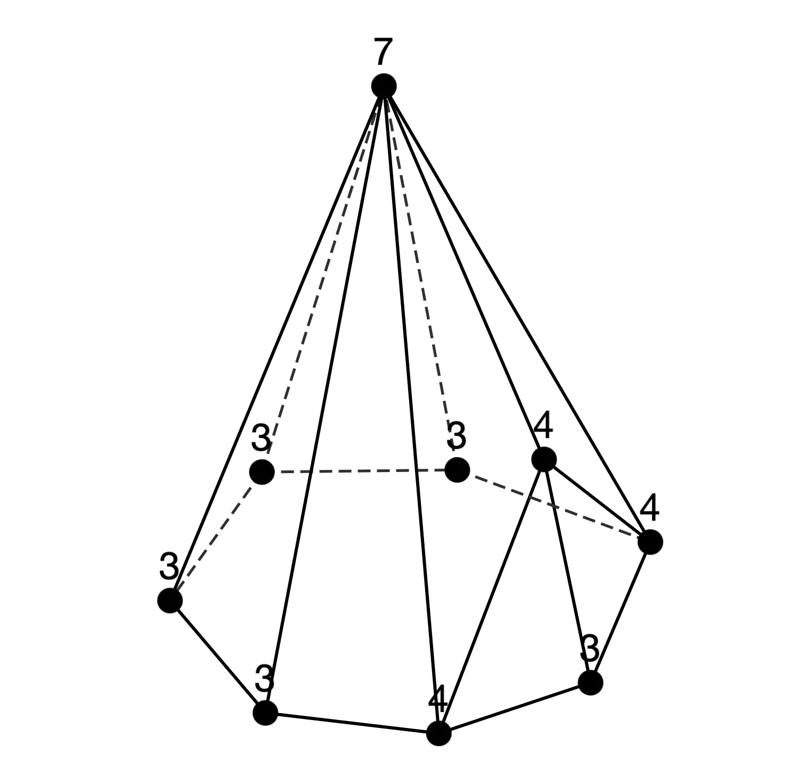
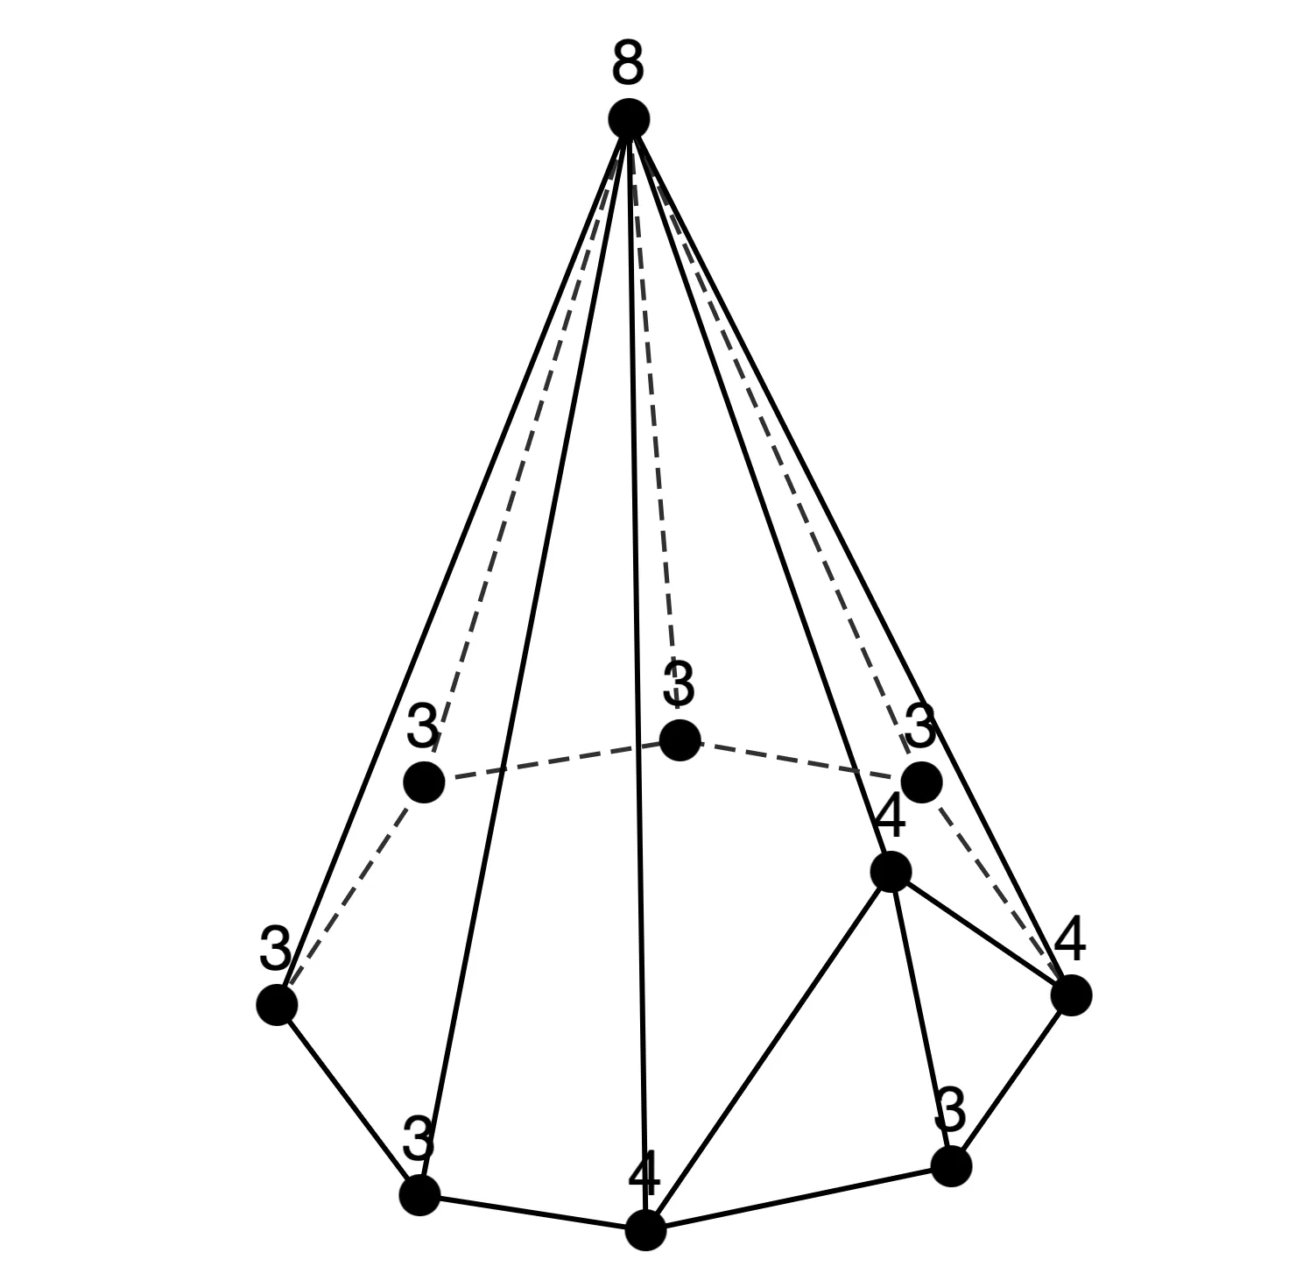
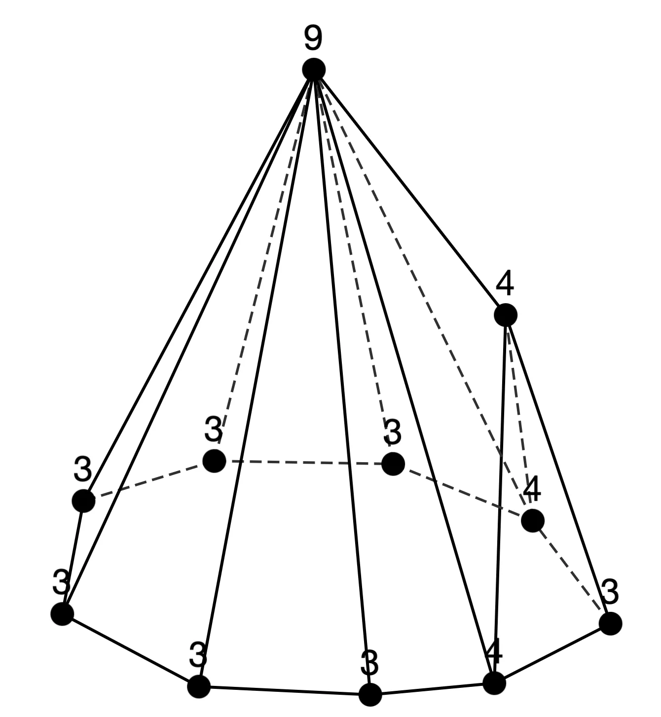



Sequence 2
n = 9 (20 types)
n = 10 (34 types)
n = 11 (54 types)

Slide 23



Sequence 3
n=6: [3,5][3,1] (=[3,6])
n=7: [3,6][4,1]
n=8: [3,7][5,1]
n=9: [3,8][6,1]
n=10: [3,9][7,1]
n=11: [3,10][8,1]
n = 6 (1 type)
n = 7 (2 types)

Slide 24





Sequence 3
n = 8 (2 types)
n = 9 (3 types)

Slide 25



Sequence 3
n = 10 (3 types)

Slide 26




Sequence 3
n = 11 (4 types)

Slide 27






Sequence 4
n=6: [3,0][4,5][4,1] (=[4,6])
n=7: [3,1][4,5][5,1]
n=8: [3,2][4,5][6,1]
n=9: [3,3][4,5][7,1]
n=10: [3,4][4,5][8,1]
n=11: [3,5][4,5][9,1]
n = 6 (1 type)
n = 7 (1 type)
n = 8 (5 types)
n = 10 (45 types)
n = 9 (15 types)
n = 11 (112 types)

Slide 28
Sequence 4
n = 8 (5 types)
n = 9 (15 types)
n = 10 (45 types)
n = 11 (112 types)

Slide 29




Sequence 5
n=7: [3,2][4,2][5,2][6,1]
n=8: [3,3][4,2][5,2][7,1] n=9: [3,4][4,2][5,2][8,1] n=10: [3,5][4,2][5,2][9,1]
n=11: [3,6][4,2][5,2][10,1]
n = 7 (1 type)
n = 8 (3 types)

Slide 30






Sequence 5
n = 9 (9 types)

Slide 31






Sequence 5
n = 9 (continued)
n = 10 (17 types)

Slide 32






Sequence 5
n = 10 (continued)

Slide 33





Sequence 5
n = 10 (continued)

Slide 34


Sequence 5
n = 10 (continued)
To-do
Observe what kind of polyhedron each of the other sequences corresponds to.

Slide 35
Future directions
No prior research found on categorizing polyhedral graphs with continuous parameters.
A literature review is still necessary for confirmation.
Need to summarize connection to polyhedral unfolding.
Aim to prepare a draft for the LA Symposium.
Non-refereed symposium in Japan
Submission deadline: June 18
Draft manuscript deadline: July 21
Symposium dates: July 23–25

